Slide 1
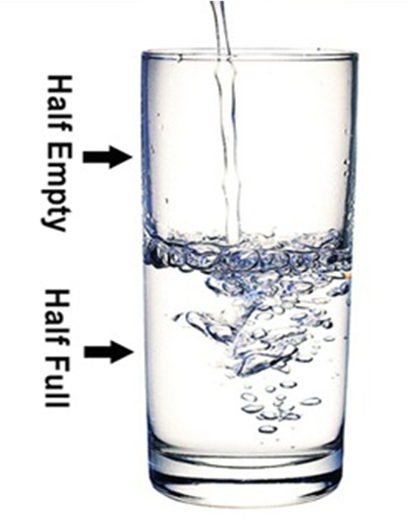
Capacity.
The amount that something can hold.
LO: Today I would like you to be able to recognise differences in quantity when comparing sets of objects.

Slide 2
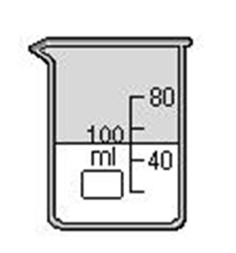
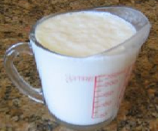
HALF FULL
Two equal parts
EMPTY
FULL
What would happen with we kept pouring?
Demonstrate with container/glass

Slide 3
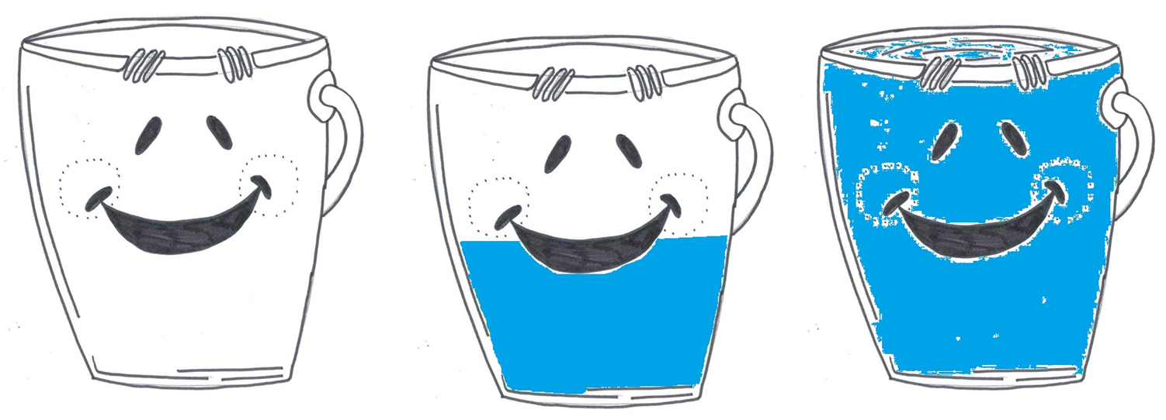
Which bucket is full, half full and empty?

Slide 4
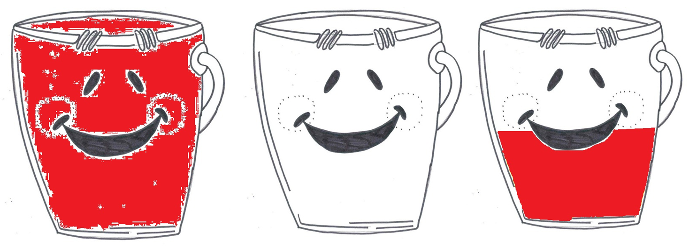
Which bucket is full, half full and empty?

Slide 5
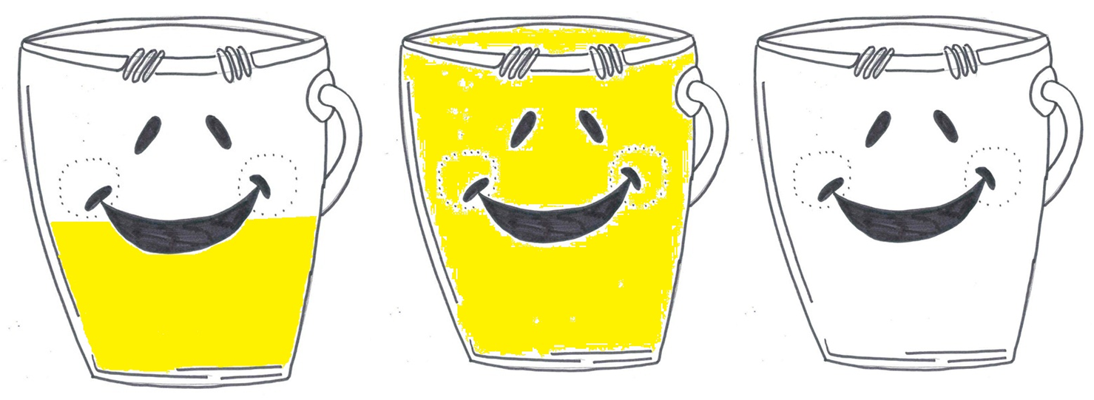
Which bucket is full, half full and empty?

Slide 6
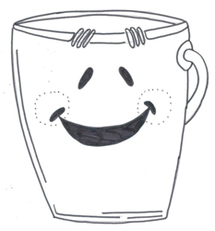
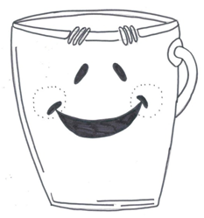
Colour in the buckets
to half full.

Slide 7
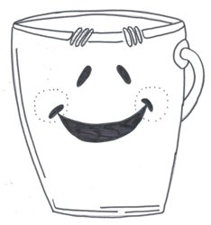
Colour in the buckets
to full.

Slide 8
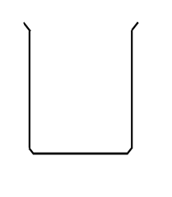
Colour the containers to show full, half full and empty.

