Slide 1
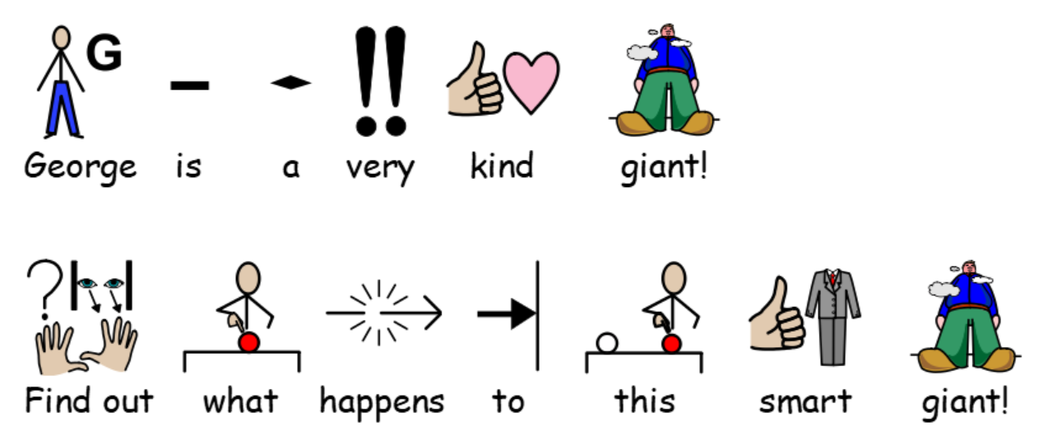

Slide 2
https://www.youtube.com/watch?v=cfiPrA8E3qE

Slide 9
