Slide 1
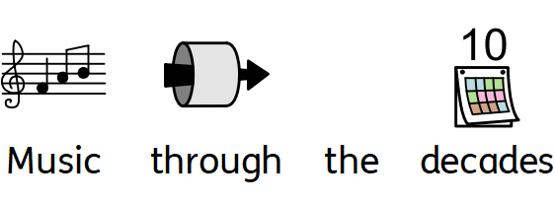

Slide 2
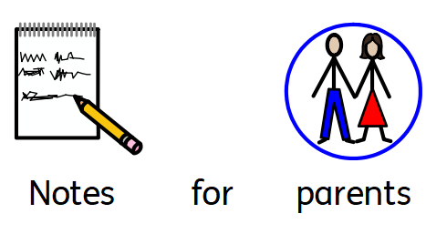
The music topic for this half term is ‘music through the decades’. For each decade between the 1920s to the 2000s there are example pieces of music from defining genres of that era. Please listen to the music with your child and use the accompanying worksheet to evaluate the music. Although there is one evaluation sheet, it is not intended that your child does all of this work in one go. They will get more from the work by breaking it up and exploring each decade in a little more detail.
All children should be able to say whether they like or do not like a piece of music and indicate this using their chosen method of communication. Some children may be able to express more and say what they do or do not like about each piece of music.
At the end of this document are some other ideas for teaching music from home with your child covering some more general musical skills.
Happy Listening ☺

Slide 3
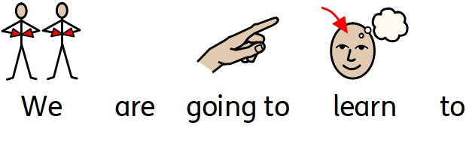

Slide 4
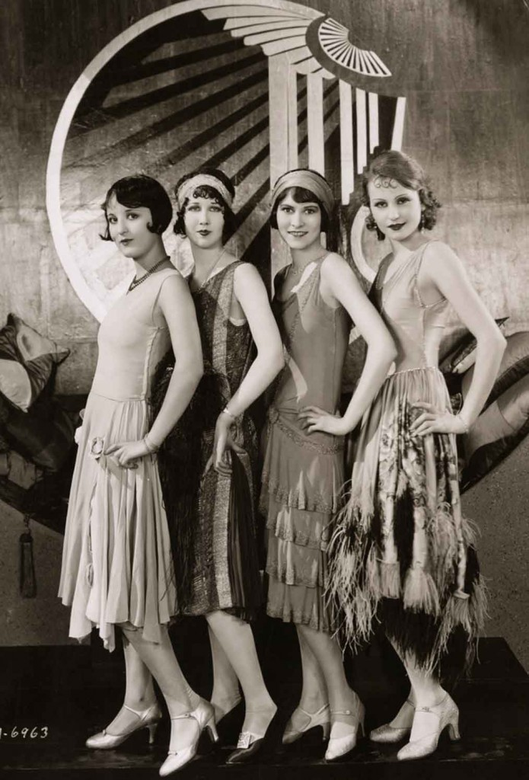
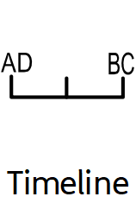
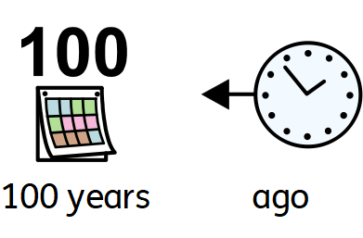
1930
1950
1970
1990
2010
1960
1980
2000
2020
1920
1940

Slide 5
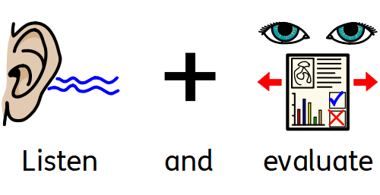
1920s
https://www.youtube.com/watch?v=B06DwBVi9LA
https://www.youtube.com/watch?v=MkGjDbKauVo

Slide 6
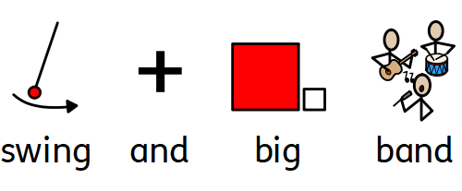
1930s-1940s
https://www.youtube.com/watch?v=r2S1I_ien6A

Slide 7
1950s
https://www.youtube.com/watch?v=lzQ8GDBA8Is

Slide 8
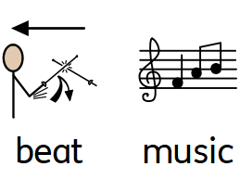
1960s
https://www.youtube.com/watch?v=jenWdylTtzs

Slide 9
1970s
https://www.youtube.com/watch?v=BonWfTW7jKc
https://www.youtube.com/watch?v=A_sY2rjxq6M

Slide 10
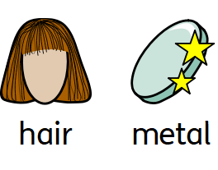
1980s
https://www.youtube.com/watch?v=vx2u5uUu3DE

Slide 11
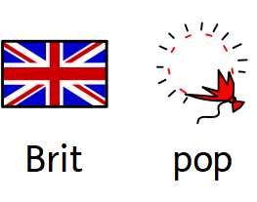
1990s
https://www.youtube.com/watch?v=r8OipmKFDeM

Slide 12
2000s
Indie Music
https://www.youtube.com/watch?v=Lp1fQ51YZMM
https://www.youtube.com/watch?v=Y5fBdpreJiU

Slide 13
There are some good ideas for doing music lessons at home on BBC Bitesize. You can find them here:
https://www.bbc.co.uk/teach/ten-pieces/get-creative-with-classical-music-at-home/z6tqqp3
https://www.bbc.co.uk/teach/bring-the-noise/half-term-music-activities/zmmpxyc/
You might like to have a go at making some musical instruments at home using resources you may already have. Some ideas are here: https://www.wikihow.com/Make-Musical-Instruments-with-Recycled-Materials
Lots of home learning music ideas can be found here: https://www.outoftheark.co.uk/ootam-at-home/
The children are likely to be familiar with this as many of our assembly songs come from out of the ark.
http://isleoftune.com/ is a website for creating music that the children have used in their music lessons in school last term. They really enjoyed it and might like to have a go at creating more pieces of music at home.

