Slide 1
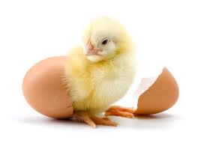
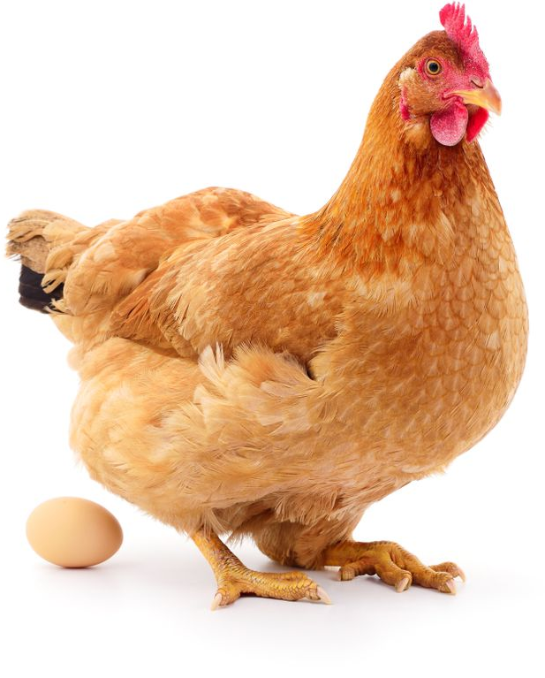
Life Cycle of a Chicken

Slide 2
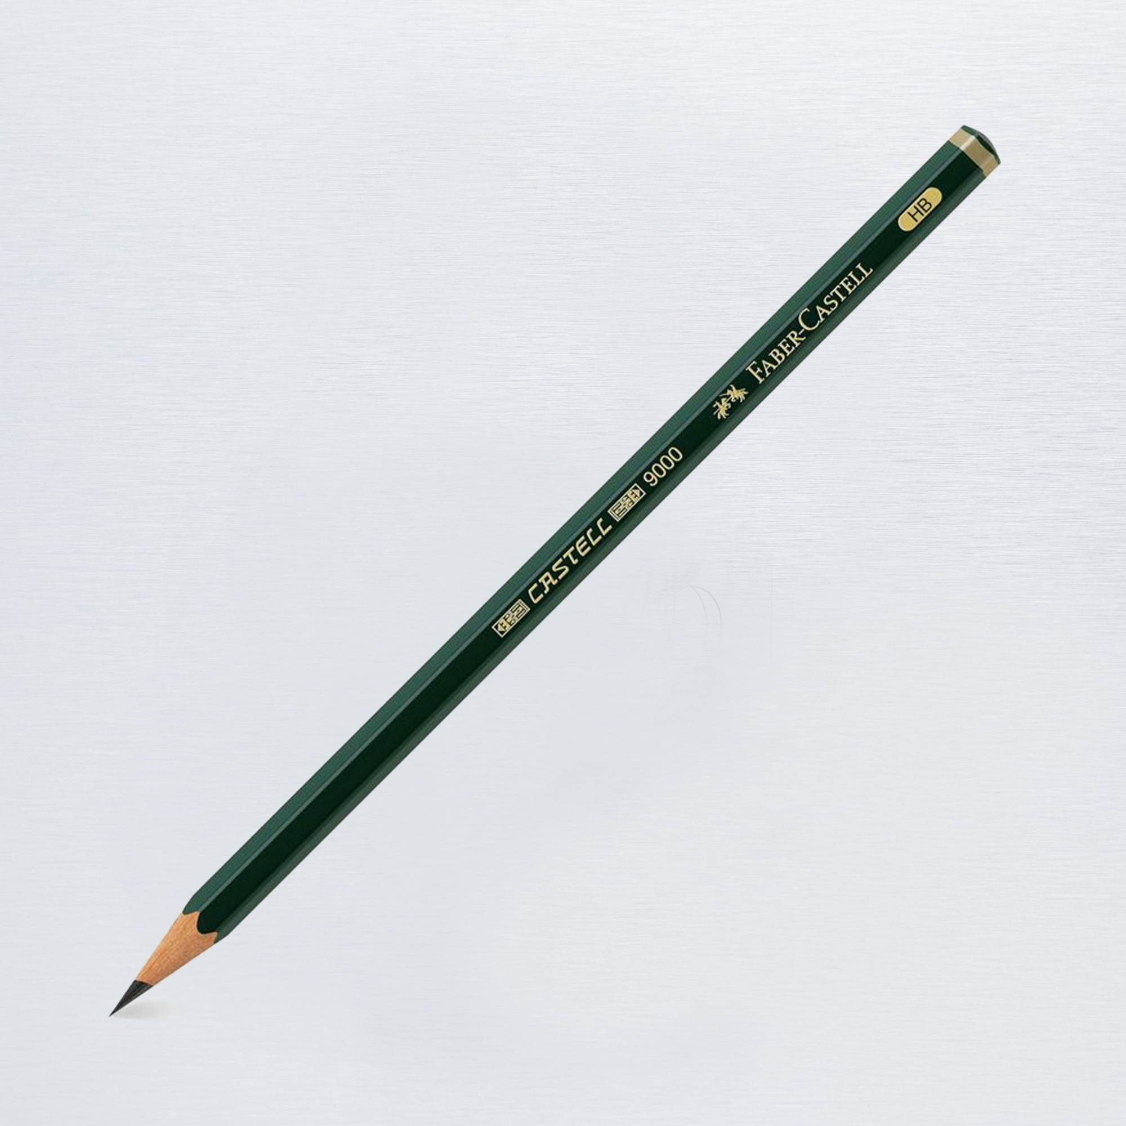
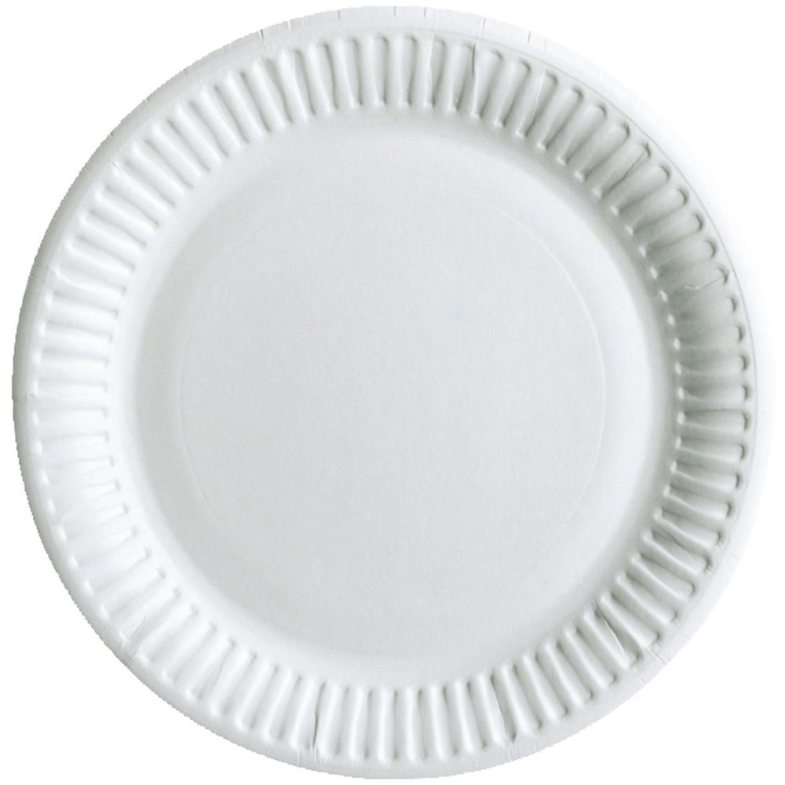
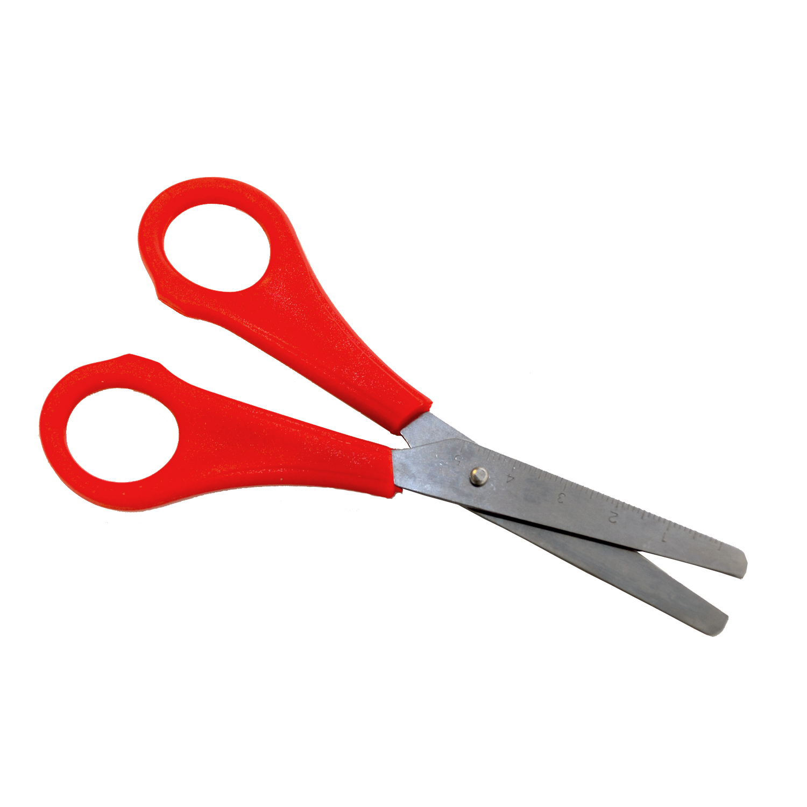
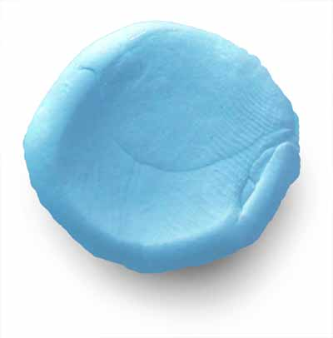
Things you need are
Pencil and color pencil
2 Papper or paper plate
Scissors
Split pin
Blue tack

Slide 3
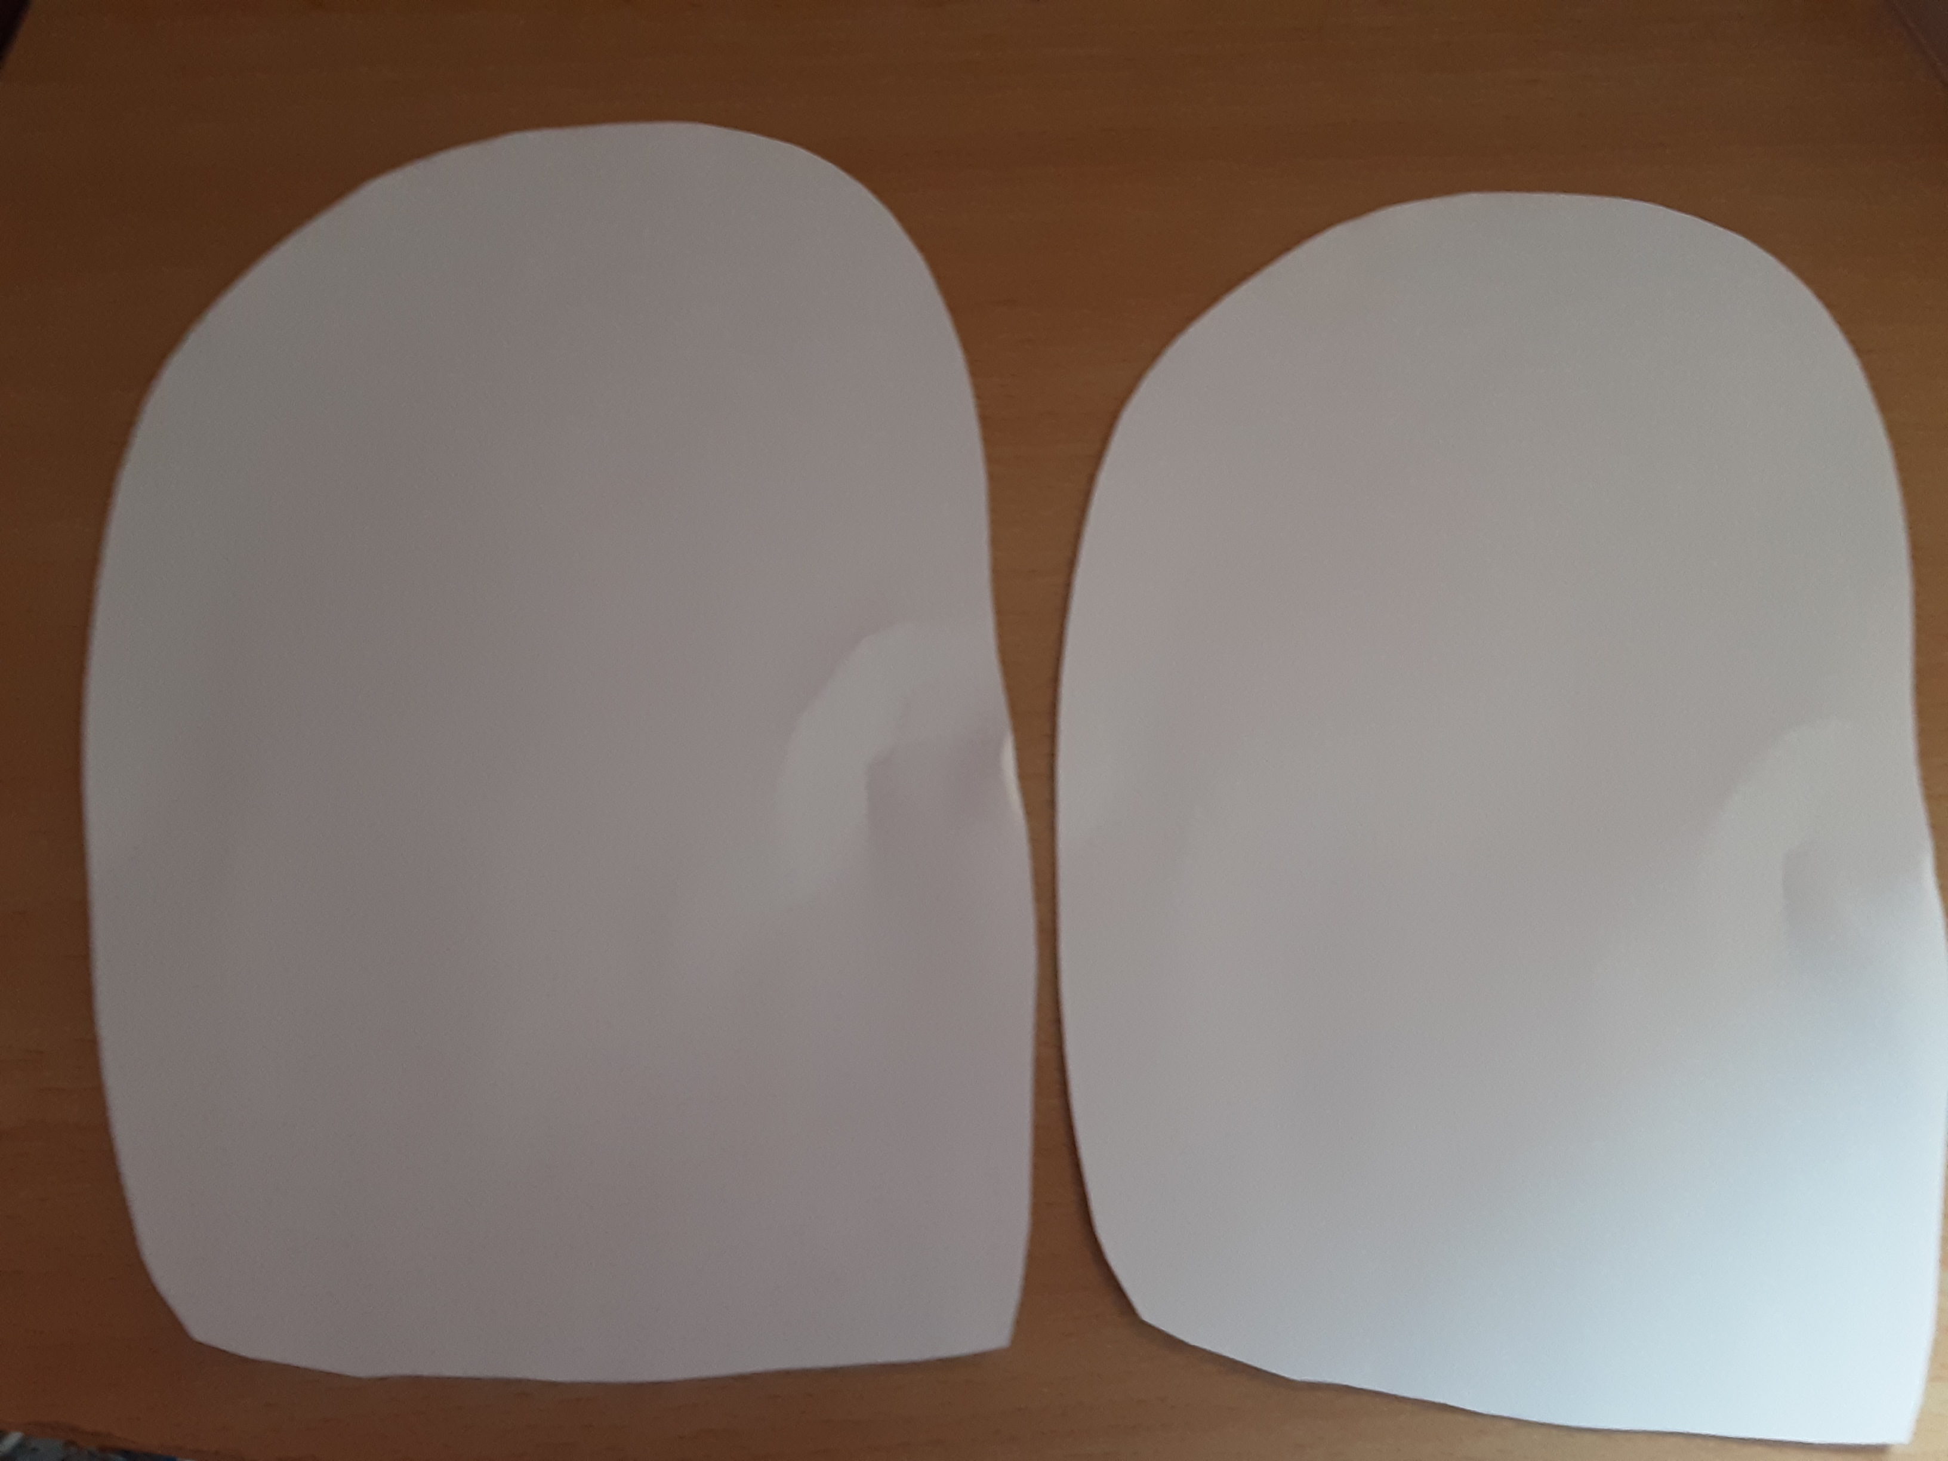
Step 1
If you didn’t have paper plate get your adult to draw 2 circle on a piec of papers and then cut the circle out.

Slide 4
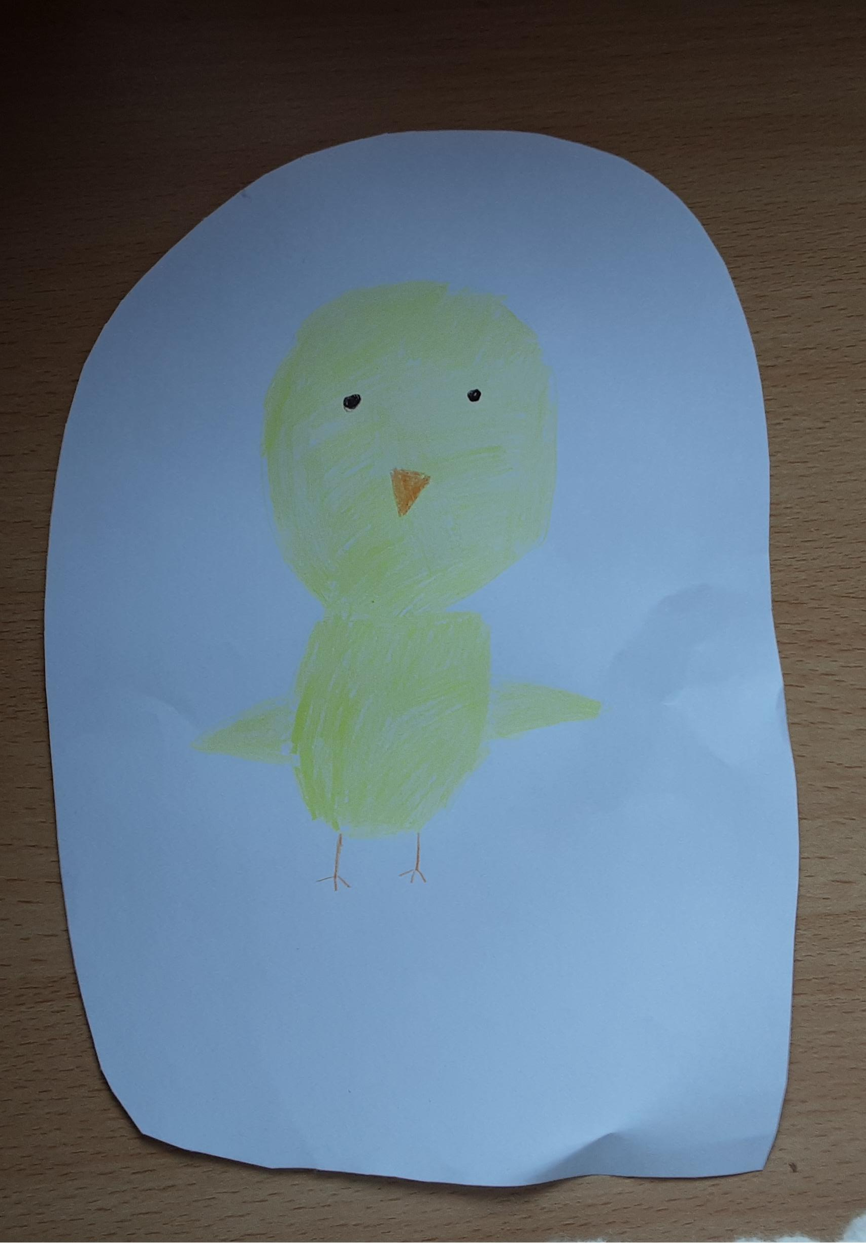
Step 2
Draw a pictures of the chicken on 1 of the circle and color the chickren in.

Slide 5
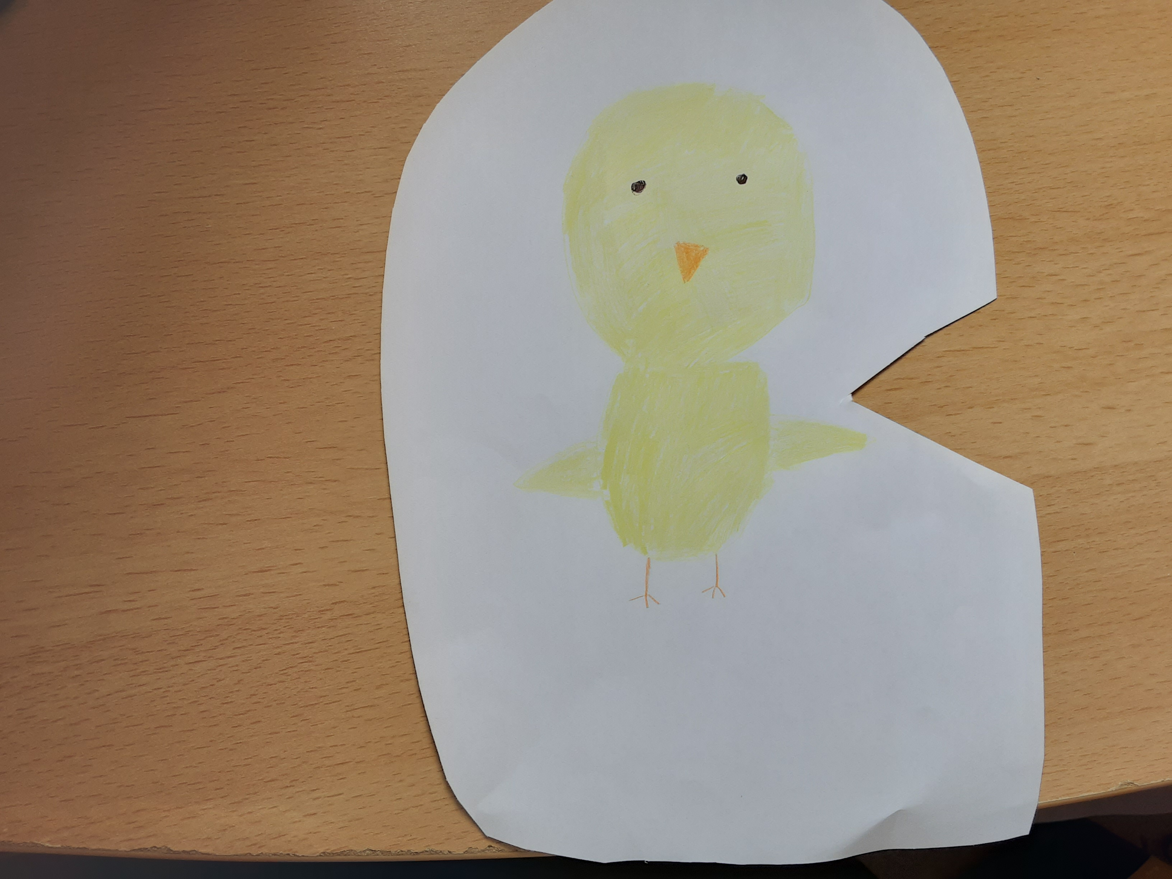
Step 3
Get a adult to cut a triangle on the edge of the circle.

Slide 7
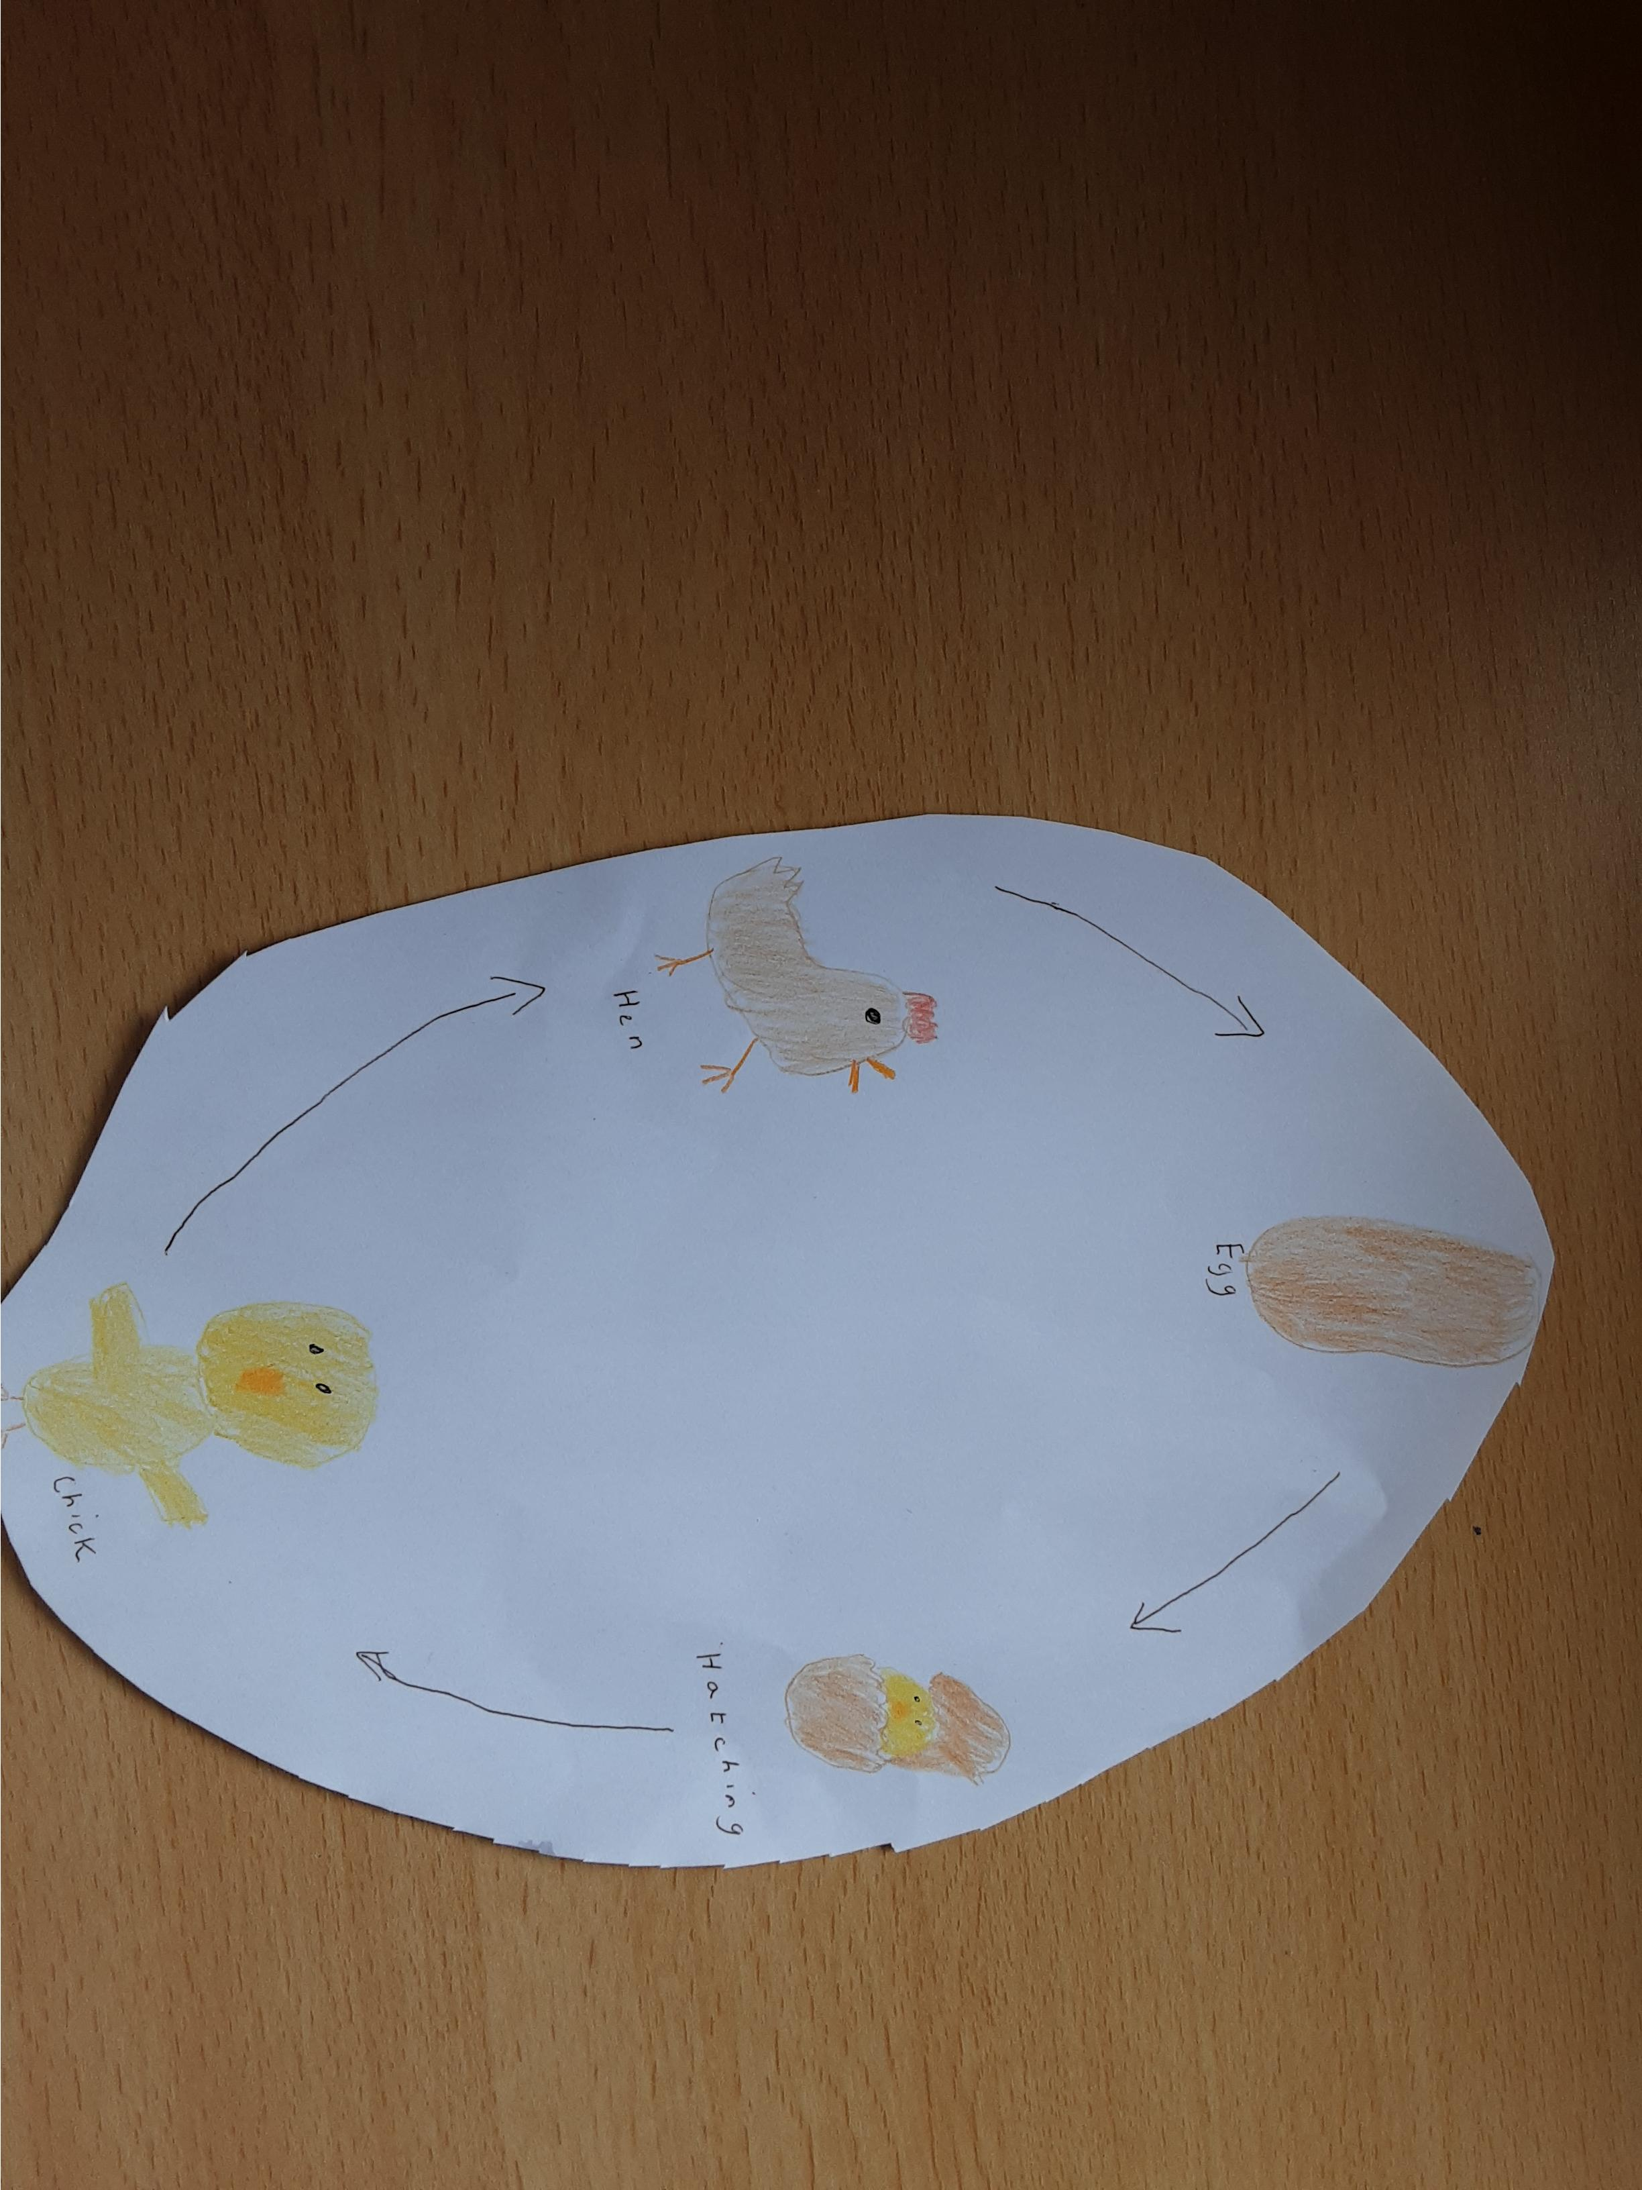
Step 4
On the 2 circle you can draw or writing the life cycle of chicken.

Slide 8
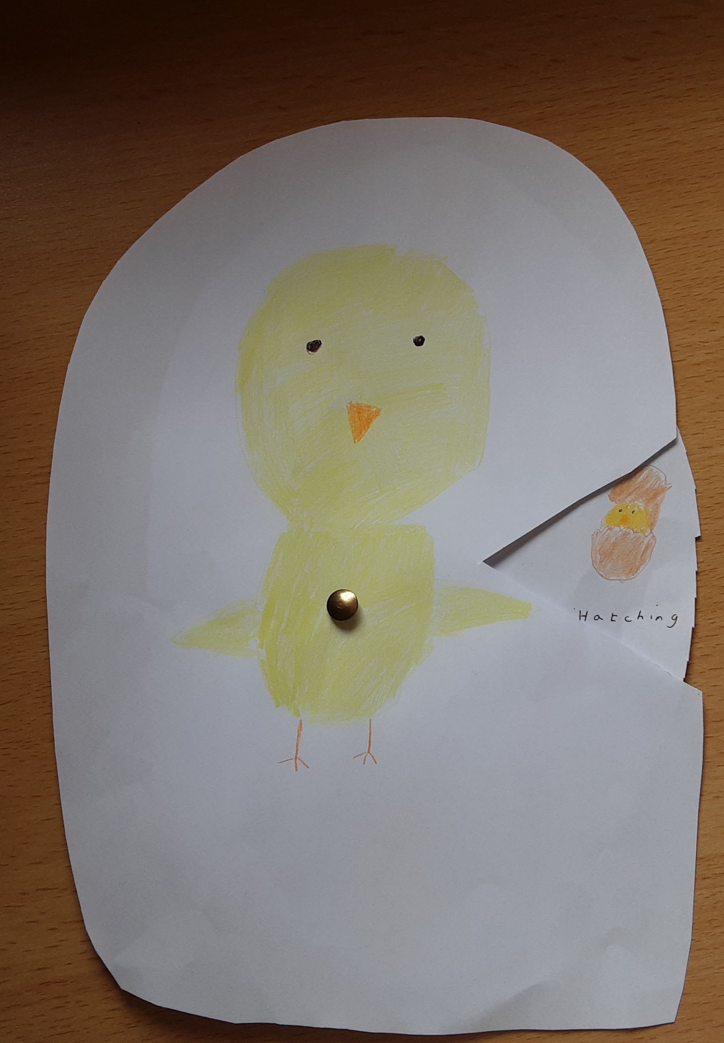
Step 5
Get adult make a small hole in the middle of the circle with a split pin.
(If it easier you could try putting blue tack at the back off circle and pushing a sharp pencil through insted)

Slide 9
Have fun making my science activists.
from Wendy

