Slide 1
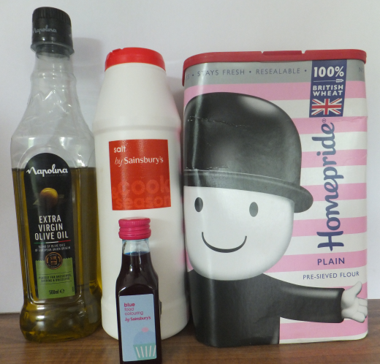
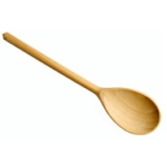
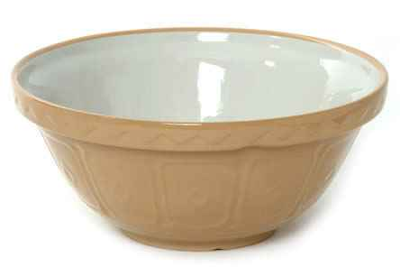
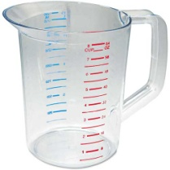
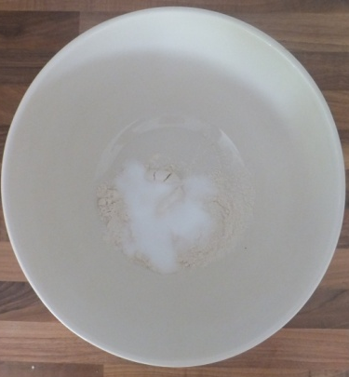
Science Activity - Materials and their properties
Make your own play-dough and see how the different ingredients combine together
What will I need?
Ingredients (don’t worry if you use a bit more or less)
500ml Plain flour
250ml Cooking salt
250ml Warm tap water
1 tablespoon Vegetable oil
Optional: Food colouring
Utensils
Spoon
Mixing bowl
Jug or cup
Method
Step One
Mix the flour and salt together in a bowl.
Questions: What do you think will happen? In what ways are the flour and salt similar, and in what ways are they different? Could you separate them again with a fine sieve?
Note: The dry ingredients stay the same, in science this is called a mixture, because there is no reaction.

Slide 2
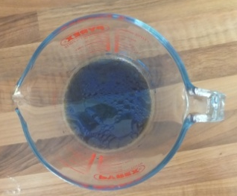
Step Two:
Mix the water, oil (and colouring if using), into a cup or jug.
Questions: What do you think will happen? In what ways are the oil and water similar, and in what ways are they different? What’s happened to the oil?
Note: The oil forms bubbles where the particles are held very tightly together, so do not mix with water, it floats on top because water is heavier than oil, and if colouring is used it will also change colour. Water and food colouring mix completely and make a solution.
Step Three:
Combine the wet ingredients with the dry ingredients and mix it all together using a spoon or your hand. You may need to add more flour or water to get the right consistency. Knead into a dough, and add more food colouring if you like for a deeper colour.
Questions: What do you think will happen? If you used colouring is it lighter or darker? Why?
Note: Mixing all your ingredients together has made something new. This is called a chemical reaction, and it would be really hard to separate these ingredients again. The water sticks the long chain like molecules called proteins in the flour together, and the salt makes these proteins even stronger and stops the play dough from going bad. The oil coats the other ingredients, and helps it not to dry out. The molecules from the food dye spread out to give it colour.

Slide 3
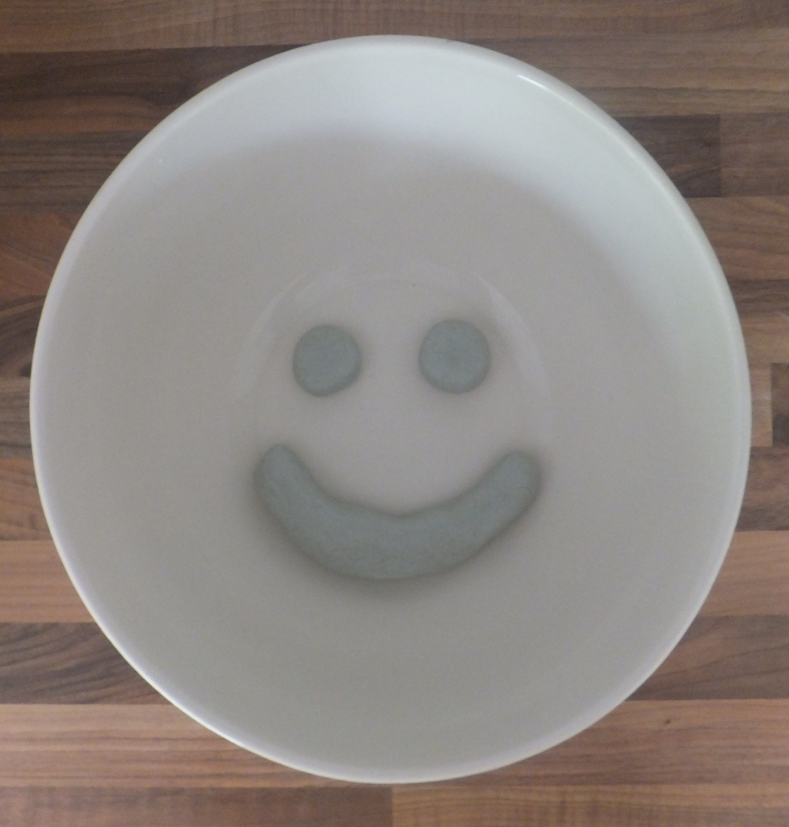
What will you model with your play dough? Have fun!
Miss Thurlow

