Slide 1
Whatever next sequencing
The children are all familiar with the story Whatever next.
Before starting this activity make sure you have read the story which you will find a PowerPoint to on the website.
Ask the children what picture would come first? If needed you can give the children two pictures at a time and see If they can find the correct picture.
3. As the children are sequencing the photos ask questions such as:
How does baby bear feel?
What food would you take to the moon for a picnic?
What would you wear?
What can you see in the picture?
4. When the story is sequenced the children can colour in the pictures.

Slide 2
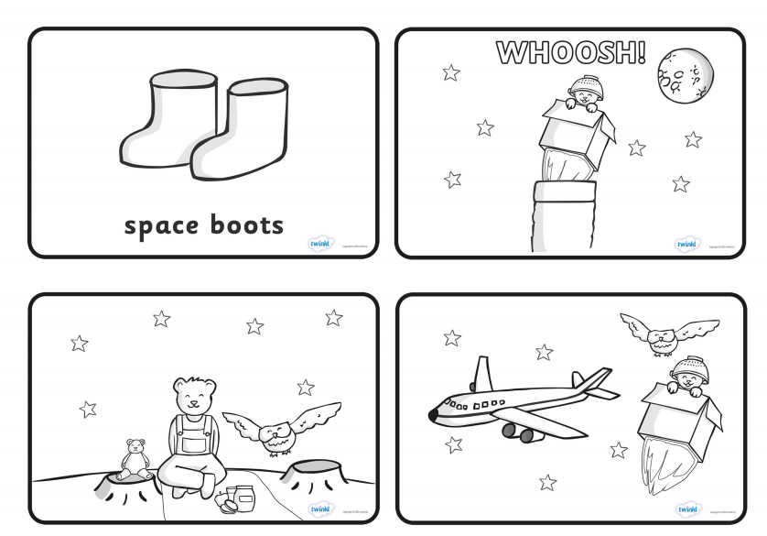

Slide 3
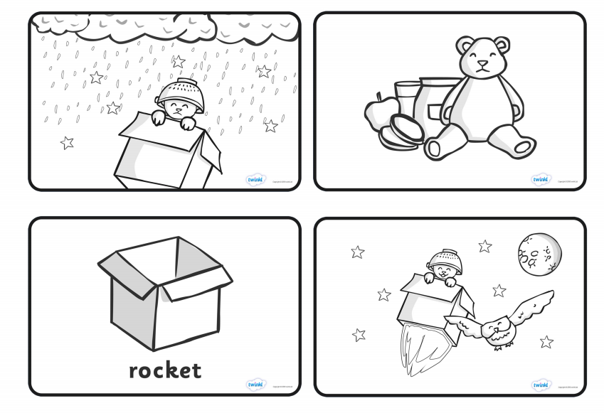

Slide 4
