Slide 1
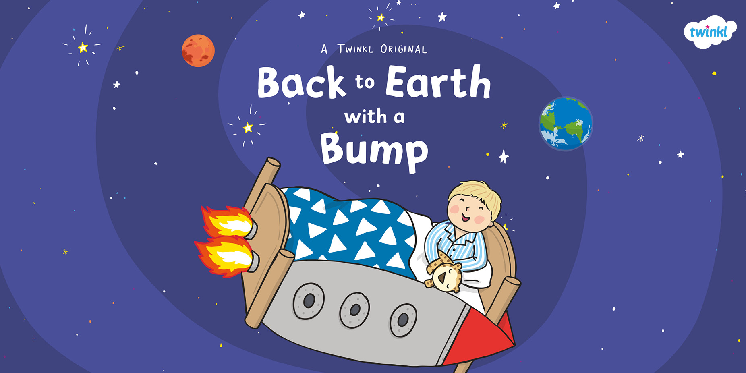

Slide 2
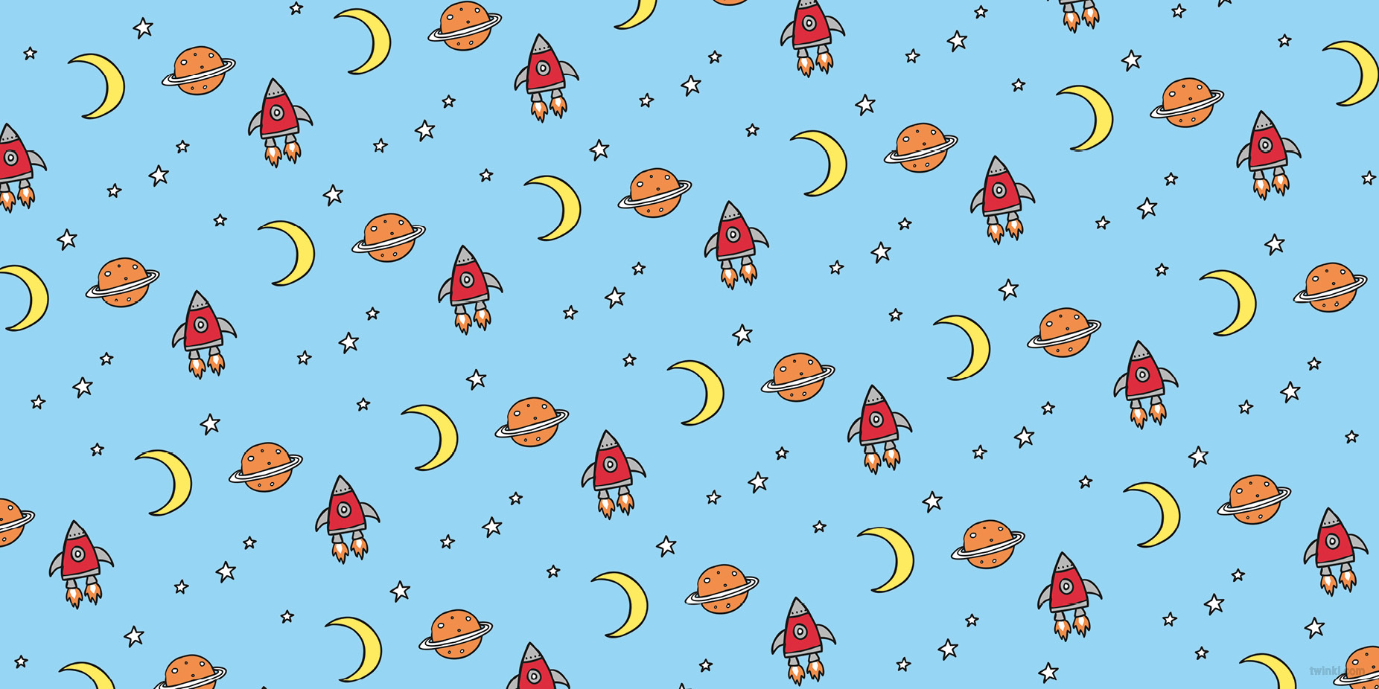

Slide 3
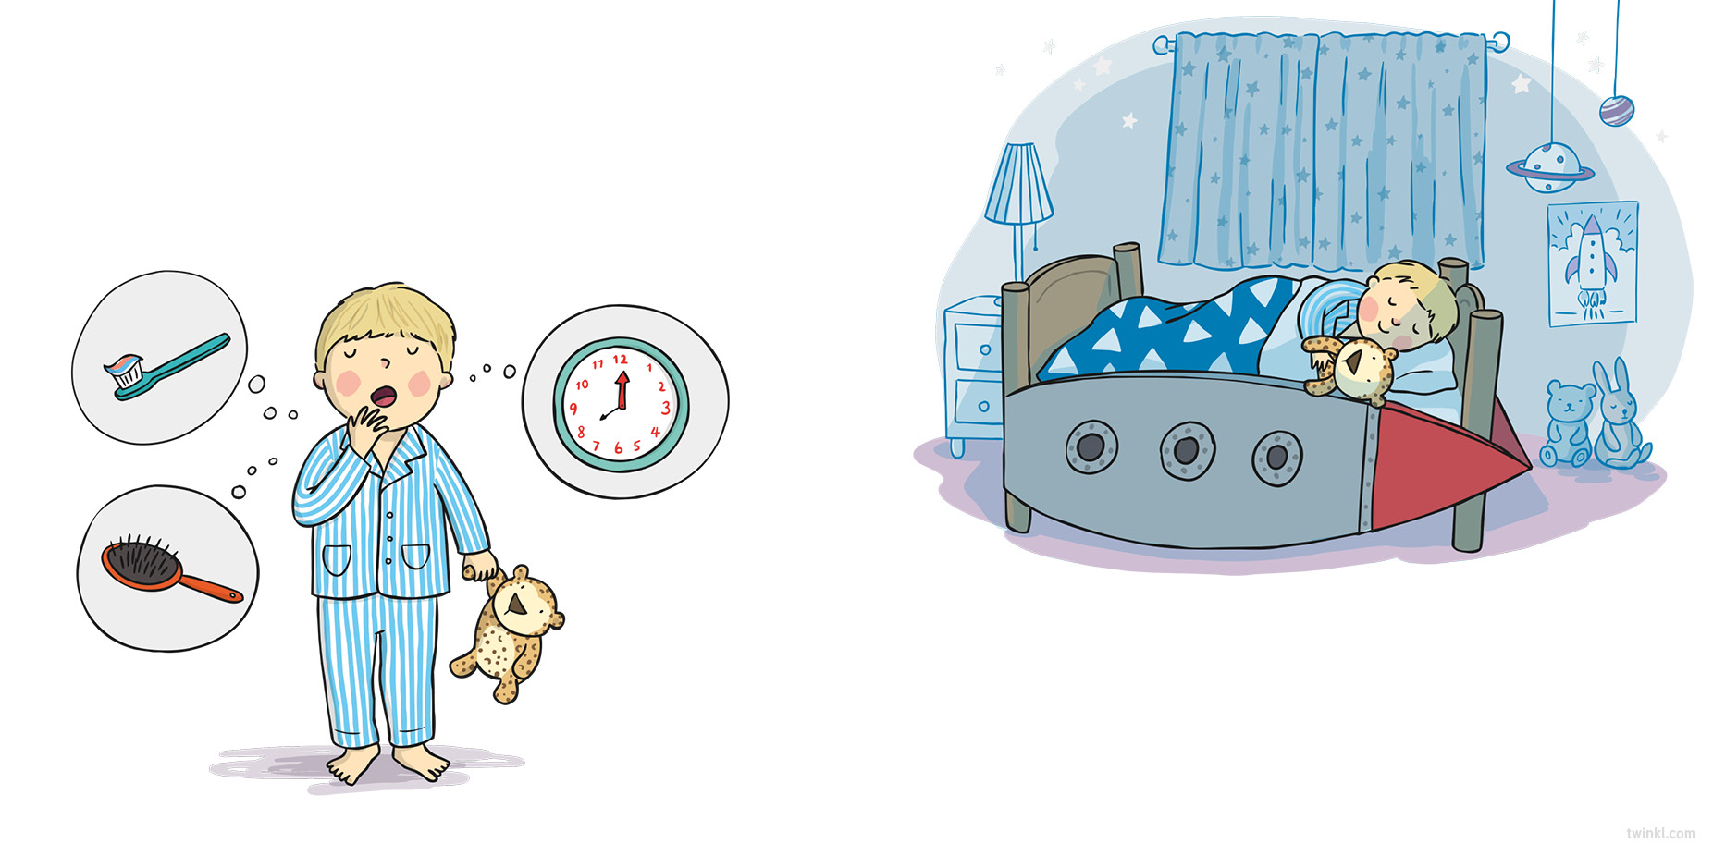
It’s evening and Hal needs to go up to bed.
He brushes his teeth and he brushes his head.
The big hand’s on twelve and the small hand’s on eight.
Quick, into your bedroom – it’s really quite late!
Hal closes his curtains and turns out the light,
Curls under his blanket and snuggles up tight.
But just when he’s starting to snuffle and snore…

Slide 4
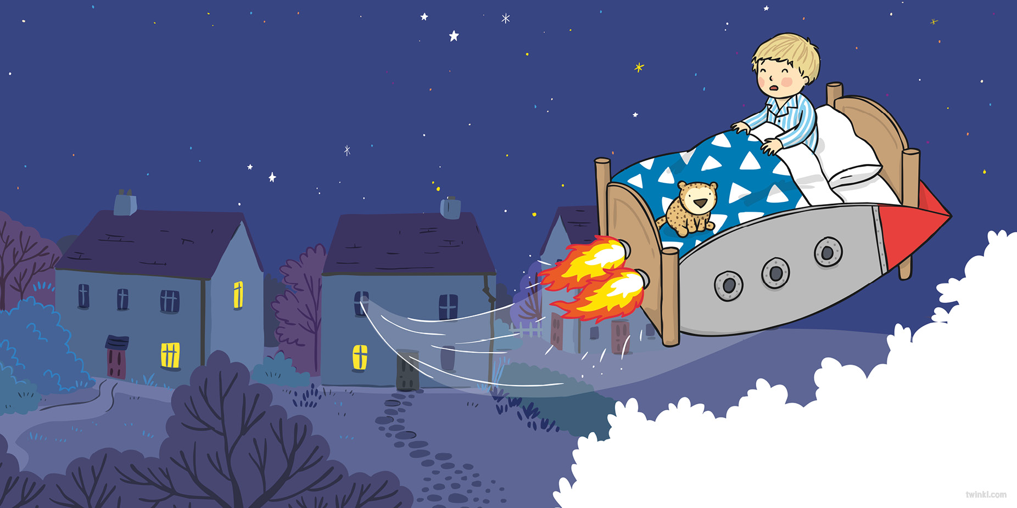
…his small bed takes off from the ground with a roar!
A whoosh! and it’s out of the window they go.
His house soon becomes just a dot down below.
He soars through the clouds and the dark moonlit sky
And straight into space in the blink of an eye.

Slide 5
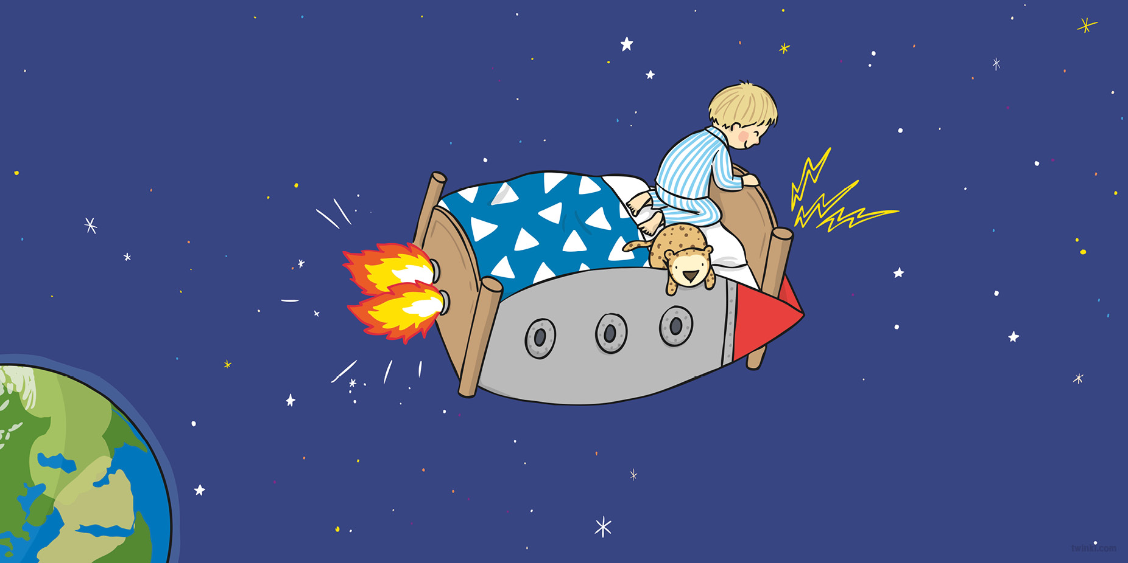
“It’s Earth calling Hal! Can you hear me? Come in!
We’ve a mission for you – when can you begin?”
“You’re loud and you’re clear, now just tell me the plan.
Please give me my mission - I’ll do what I can.”
“Please find us the Sun – it has gone from the sky.
It’s vanished completely; we just don’t know why.”
“OK,” agrees Hal with a nod of his head,
“I’ll track down the Sun in my space-travelling bed!”

Slide 6
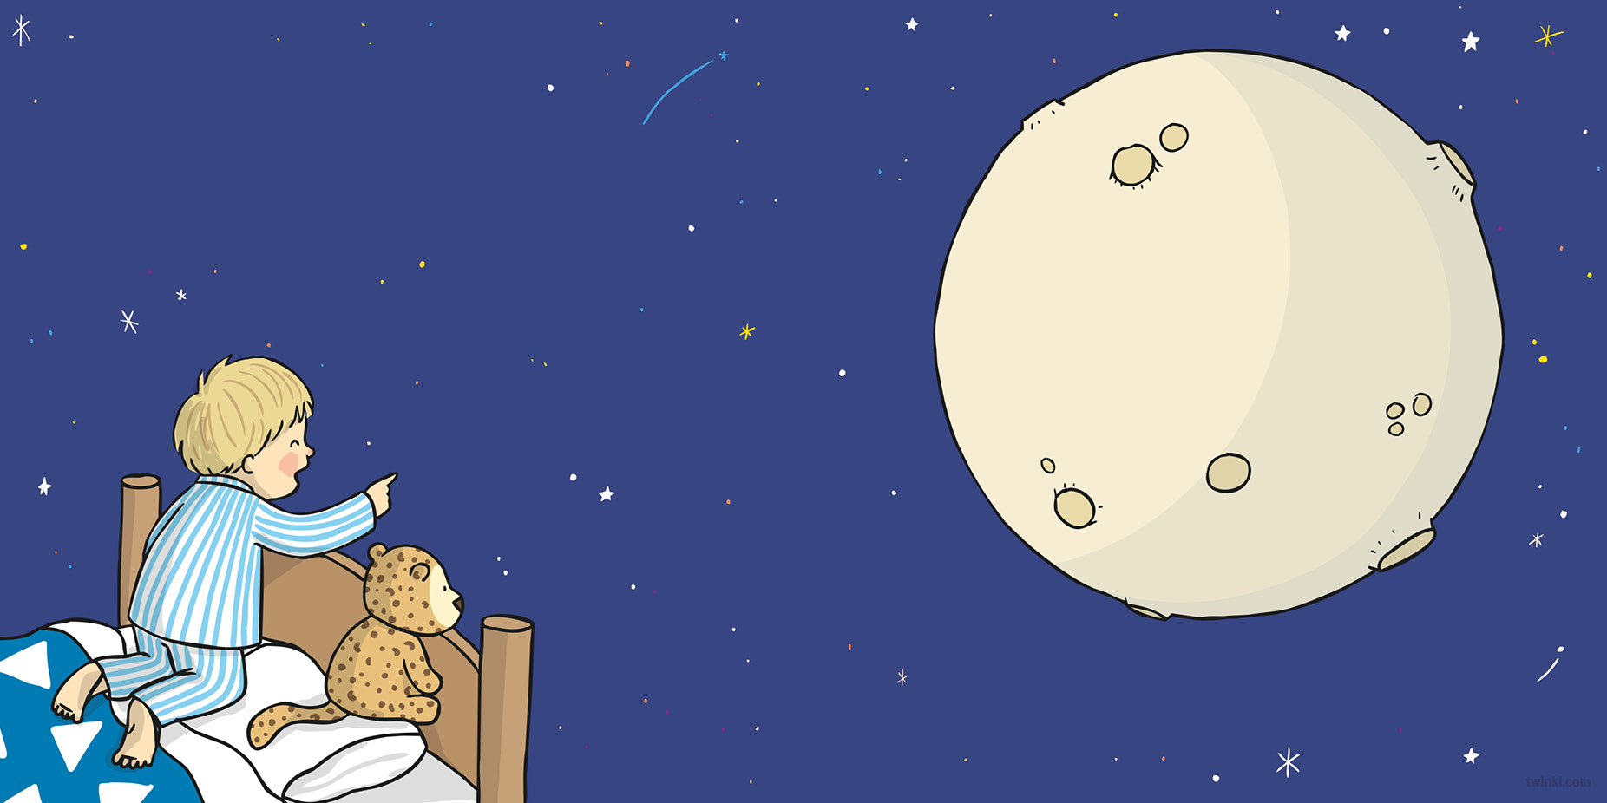
“What’s that up ahead?” Hal squints hard as he sees
A shape that is pale and all round, like a cheese!
There are craters and mountains
and dust that is grey.
Could this be the Sun that we see in the day?

Slide 7
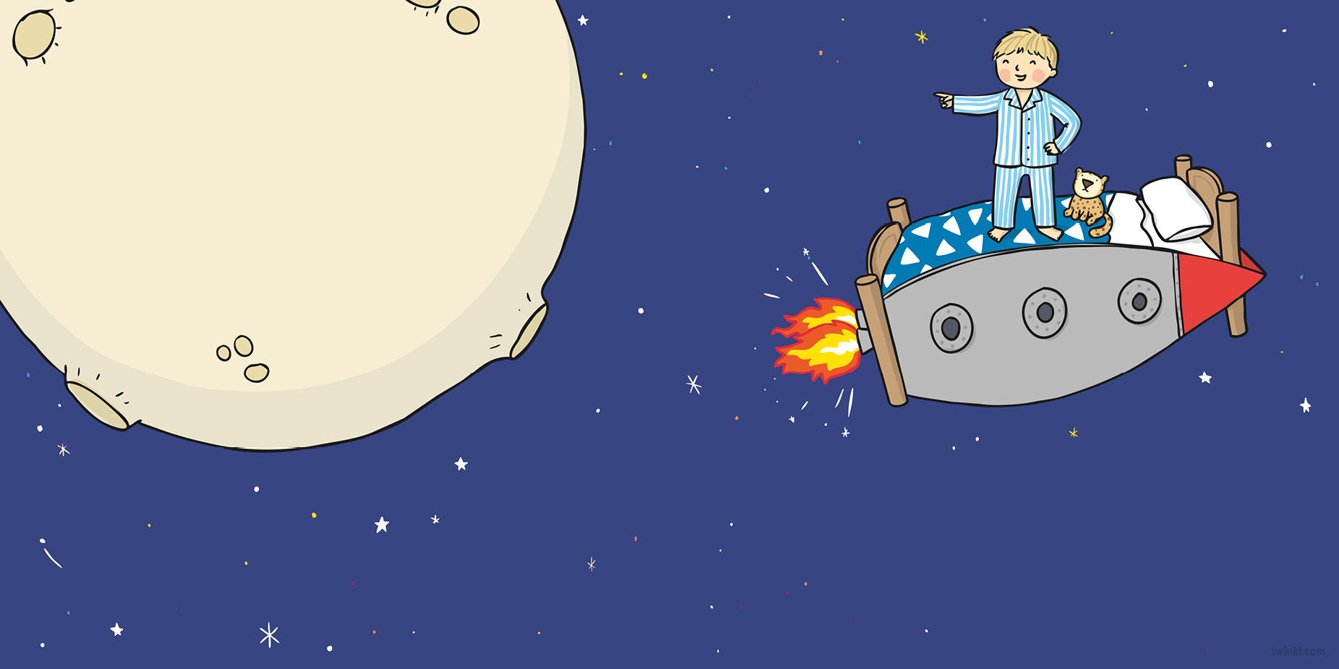
“No way!” chuckles Hal with a shake of his head,
“I know what that is!” and he stands on his bed.
“There’s just no mistaking: that sphere is the Moon!
I see it each night from my bed in my room!”
“We must find the Sun!” Hal commands with a jump,
“Before we go straight back to Earth with a bump!
I must not give up – it’s important to try.
I’ll keep up my quest for the Sun in the sky.”

Slide 8
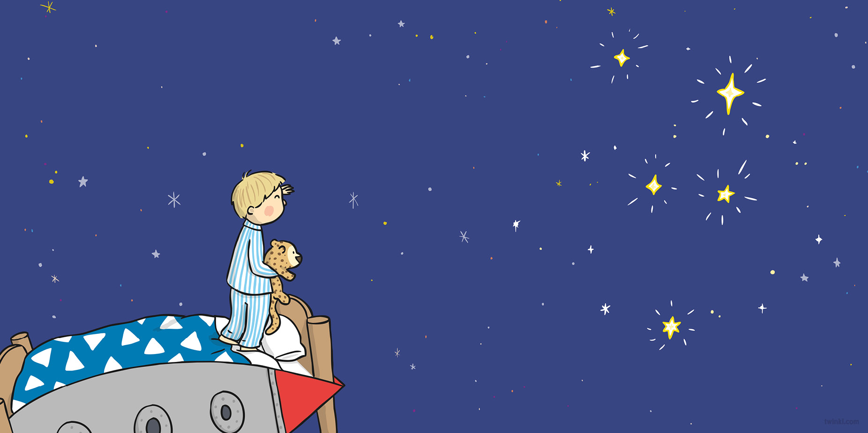
“What’s that up ahead?” Hal jumps up as he spies
Some bright twinkling shapes far ahead in the sky.
They sparkle and dazzle;
they glow with white light.
Could this be the Sun that we lost in the night?

Slide 9
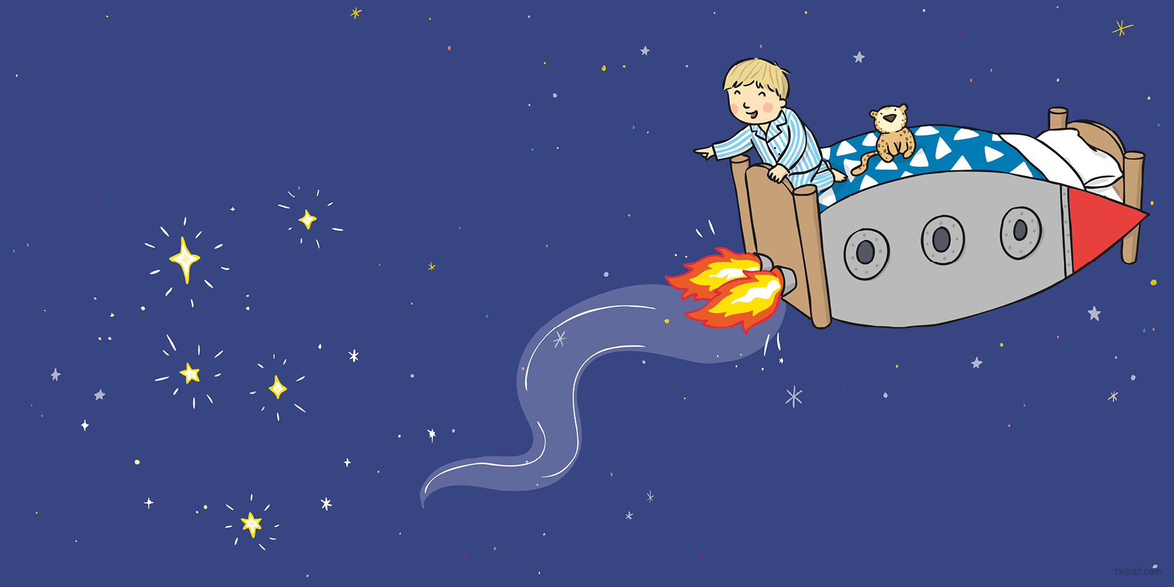
“Oh no!” giggles Hal with a wink of his eye,
“I know those small diamonds high up in the sky.
Those beautiful twinkling space dots are stars!
I’m perfectly certain that that’s what they are!”
“We must find the Sun!” Hal commands with a jump,
“Before we go straight back to Earth with a bump!
I must keep on trying, although it is hard.
I’ve done well already to find all these stars!”

Slide 10
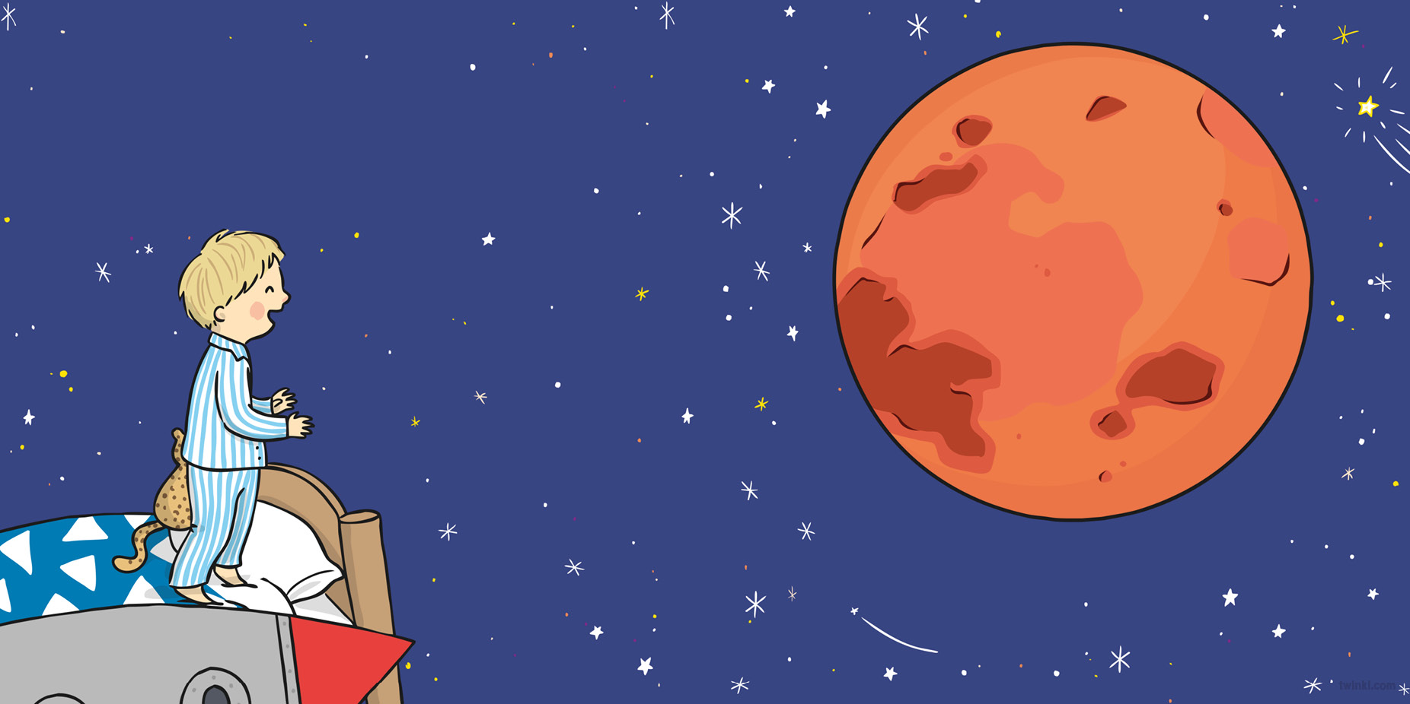
“What’s that up ahead?” Hal stands up on tiptoes
To see a vast shape that is bright red and glows.
There are mountains and valleys
and deserts so dry.
Could this be the Sun that has gone from the sky?

Slide 11
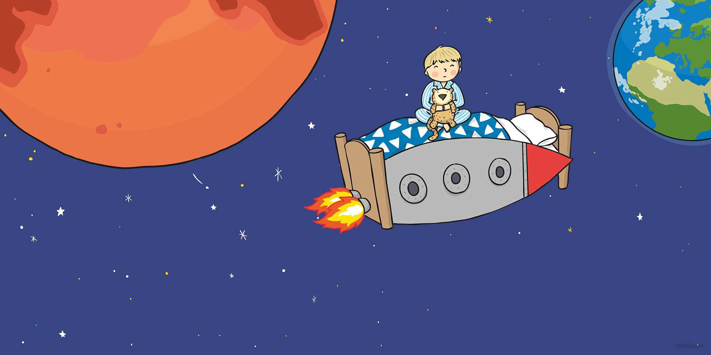
“It can’t be!” says Hal as he scratches his head,
“I know what that is – it’s so round and so red.
It’s perfectly clear that this planet is Mars!
I’ve heard it’s the planet that’s found next to ours.”
“We must find the Sun!” Hal commands with a jump,
“Before we go straight back to Earth with a bump!
This mission is hard – it’s a difficult test;
But if I have tried then I’ve given my best.”

Slide 12
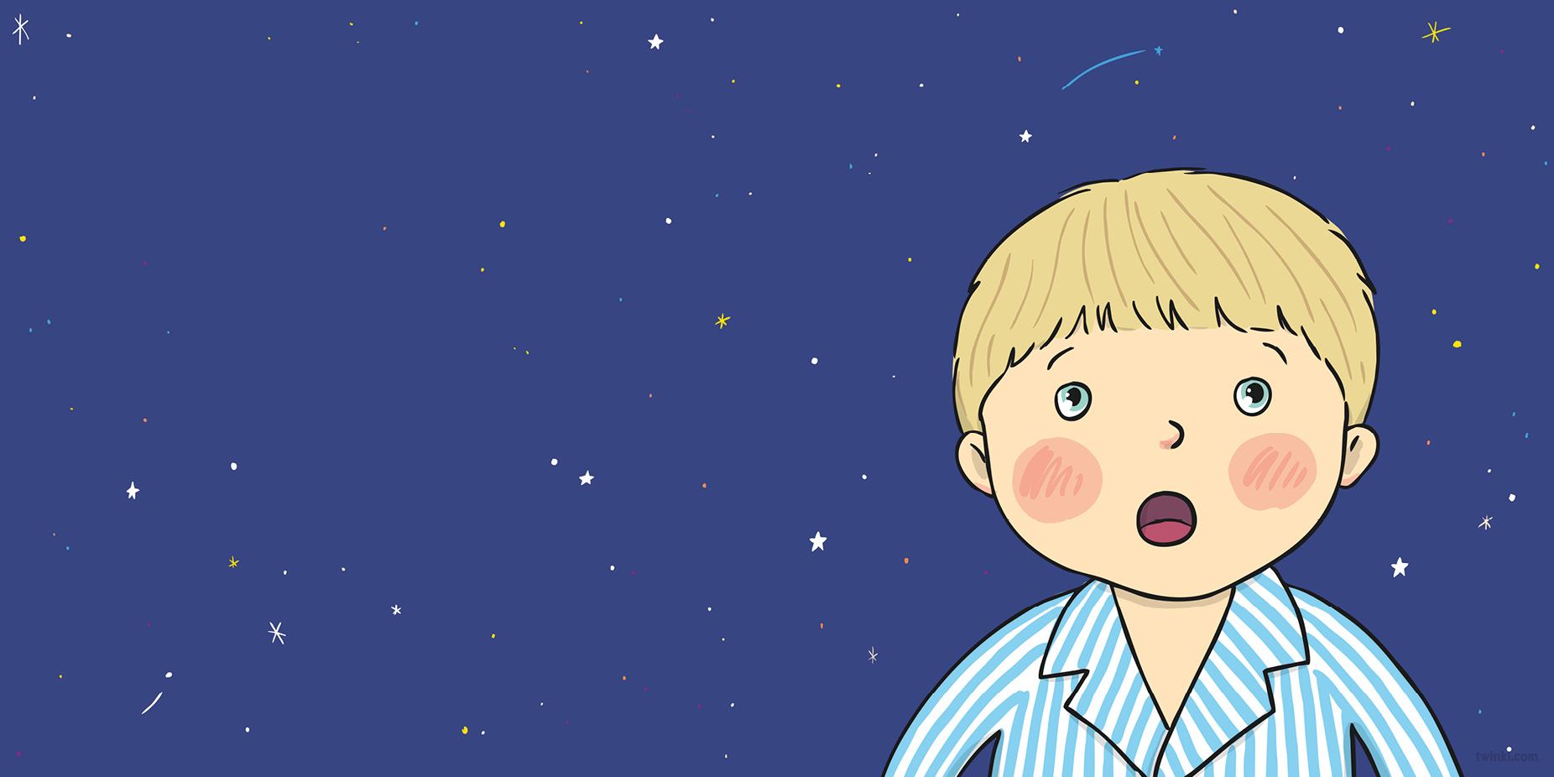
Hal looks back at Earth and then
what
does
he see?

Slide 13
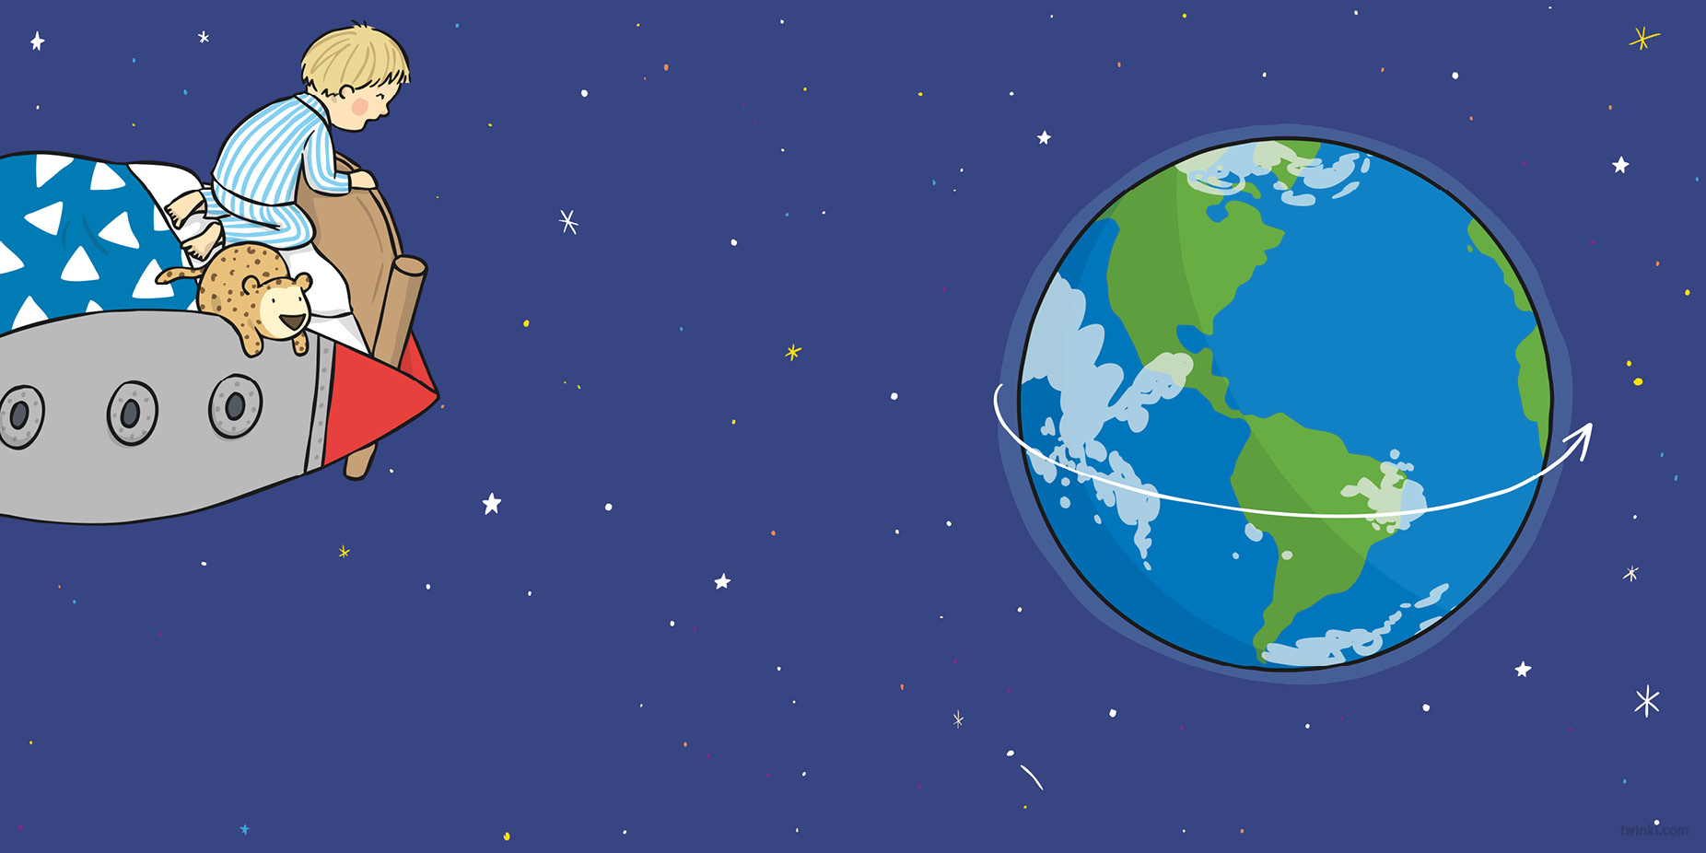
The planet is moving – it’s turning around!
It’s slowly rotating without any sound!
Hal zooms round to find where his bedroom has gone…
and what does he find? He discovers...

Slide 14
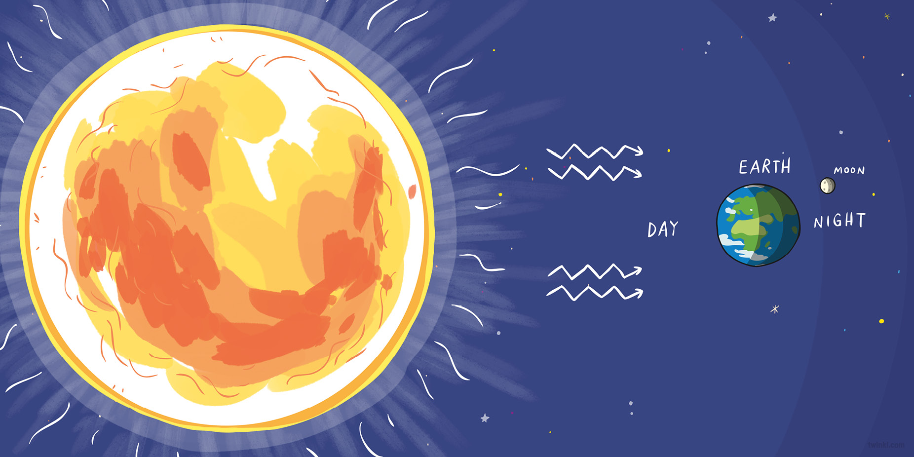
“The Sun doesn’t budge, but the Earth moves instead!”
Hal works it all out as he clings to his bed.
the Sun!
“When night comes, we see the bright Moon in the sky;
But in daytime, the Sun is the thing that we spy.”

Slide 15
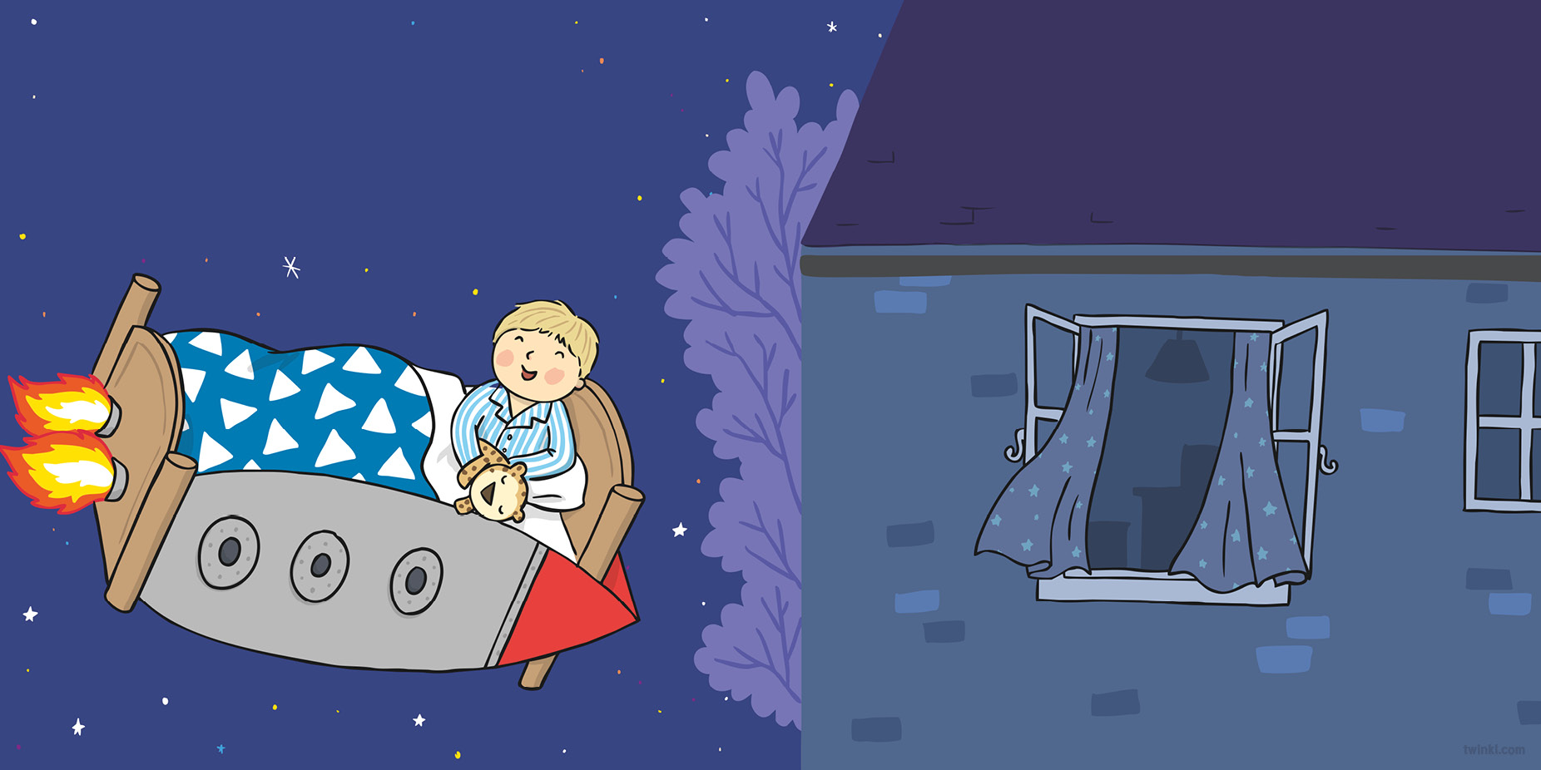
“I knew I could do it if only I tried!”
Hal smiles with delight as he looks at the sky.
The mystery is solved! Now his mission’s complete,
Hal’s suddenly tired and in need of some sleep.
“I did not give up and I did not give in,
And I found the Sun!” Hal shouts out with a grin.
He soars to his country, his town, then his street,
And straight through the window, head first and then feet.

Slide 16
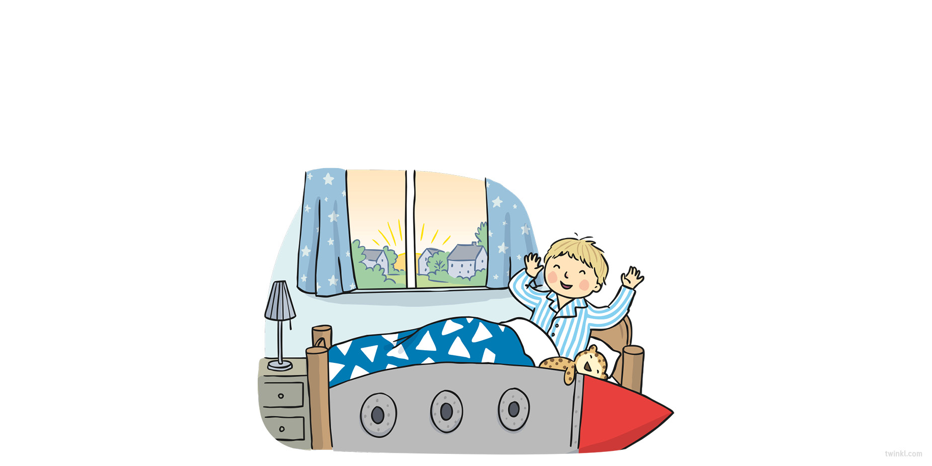
And back in his bedroom he snuggles down tight
And drifts off to sleep for the rest of the night.
As the sun starts to rise, Hal wakes up with a jump
And finally comes
back
to Earth
with a
bump.

Slide 17
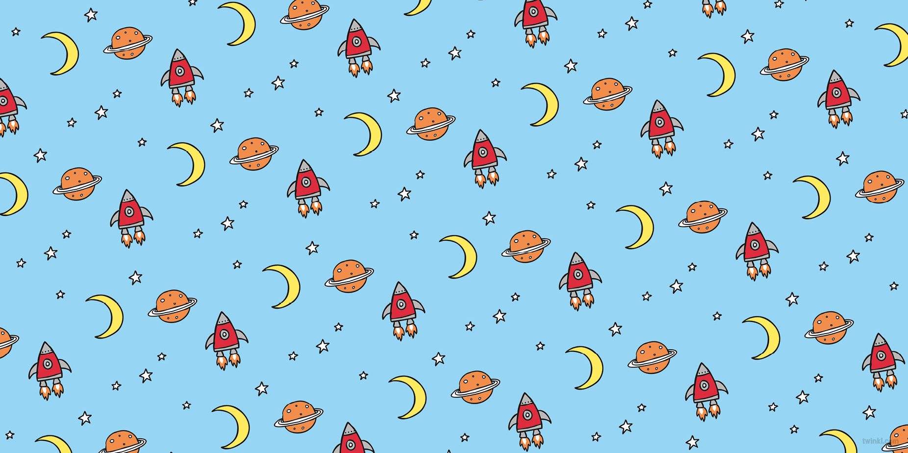

Slide 18
