Slide 1
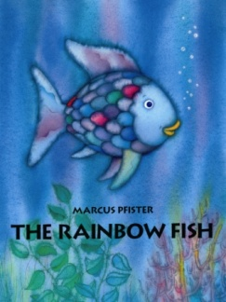
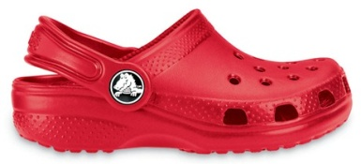
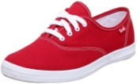
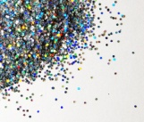
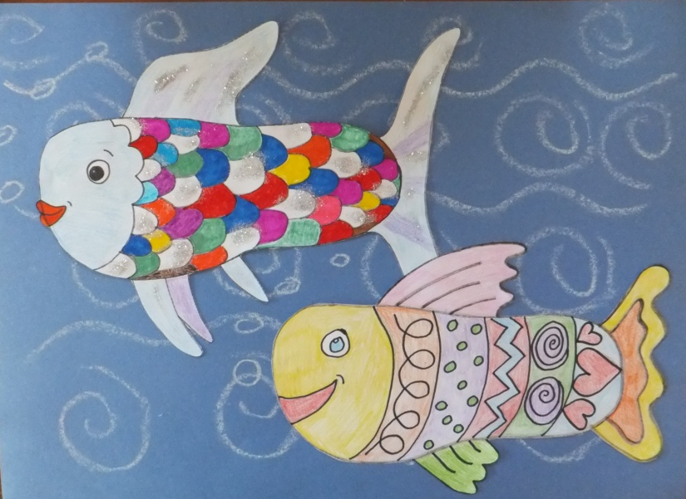
Do you remember ‘The Rainbow Fish’ story?
Here’s how to make a picture of a fish, by drawing around your shoe!
And if you want to hear ‘The Rainbow Fish’ by Marcus Pfister again here’s a link https://www.youtube.com/watch?v=r9mryuEKkKc
You will need…
And you may like to decorate it using…
Shoe Fish
Paper – or why not use some cardboard from the recycling bin
Colours – pencils, or pens, or crayons, or paints and brushes
A shoe – any shoe, boot, slipper, flip flop
Glitter, fabric, tissue paper, magazine cuttings, stickers
Scissors
Glue

Slide 2
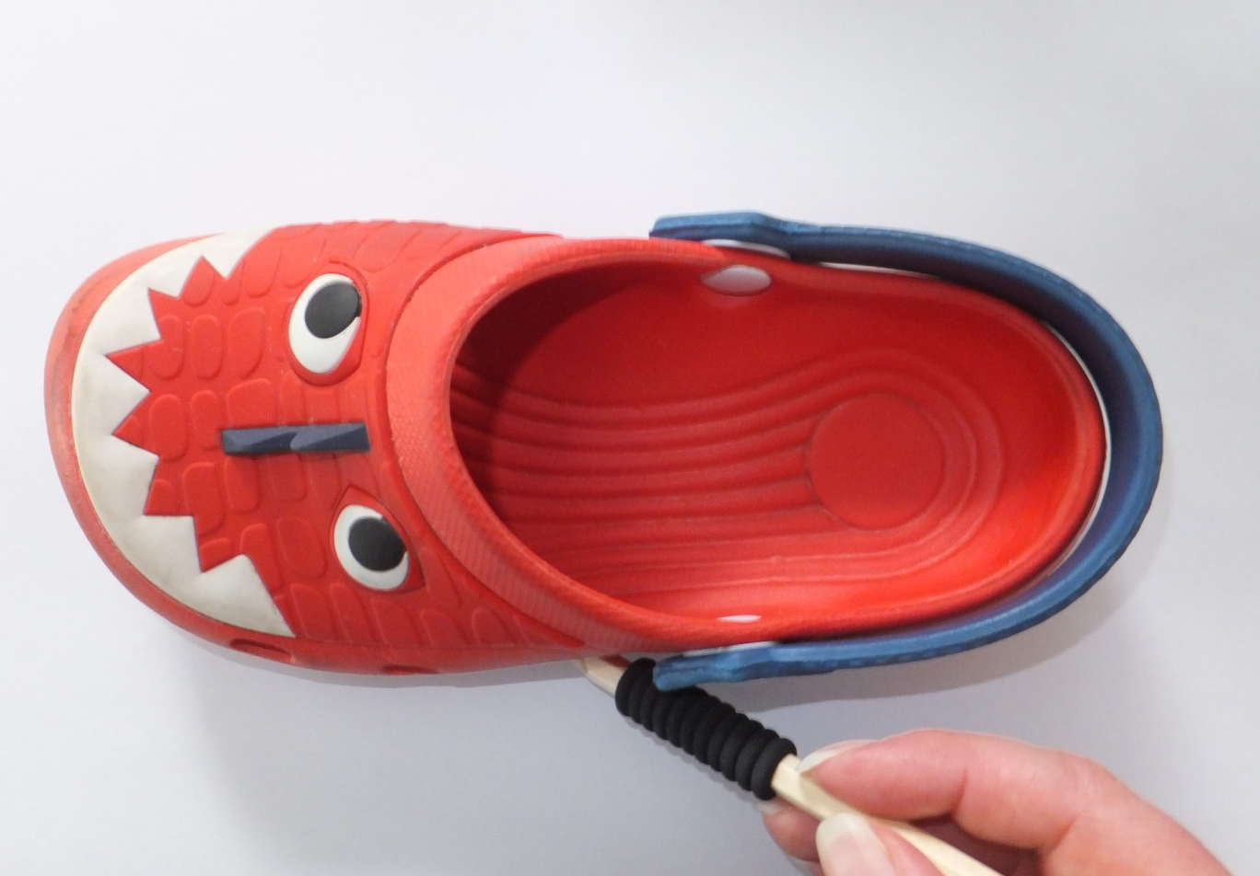
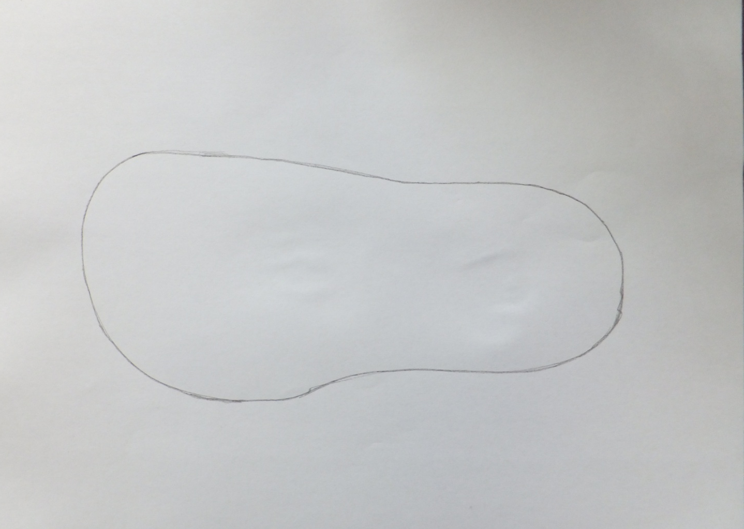
1. Put your shoe on a piece of paper and draw around it
It will look something like this

Slide 3
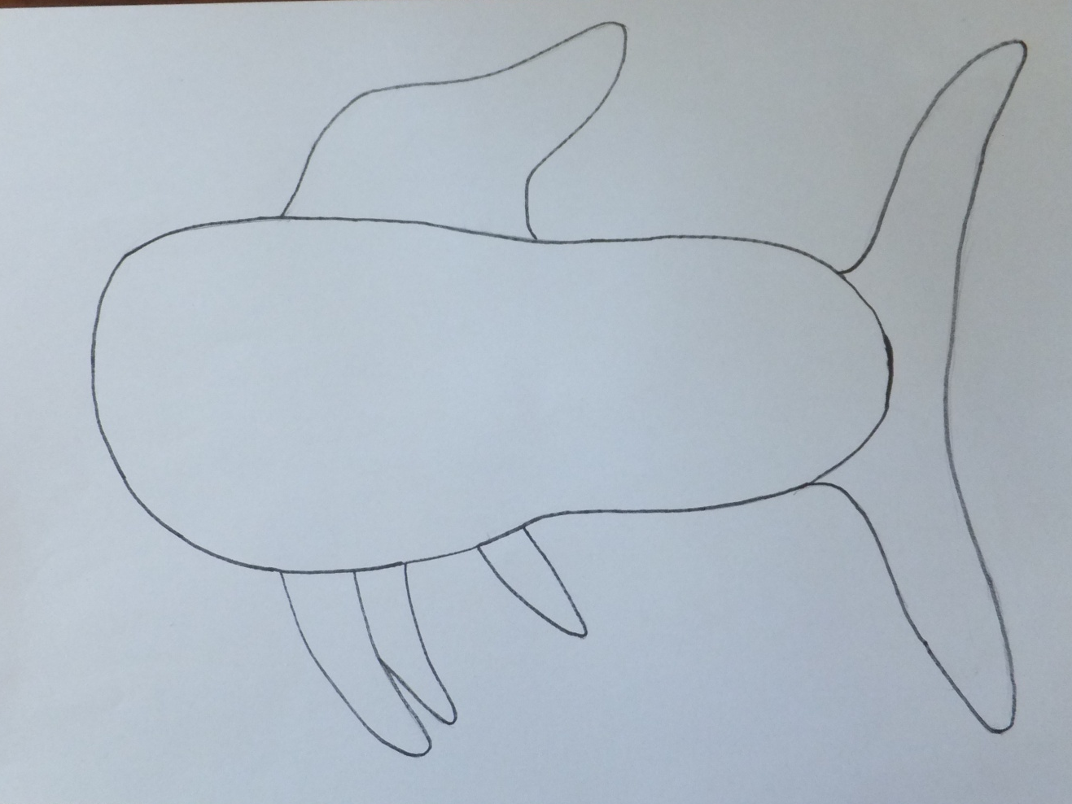
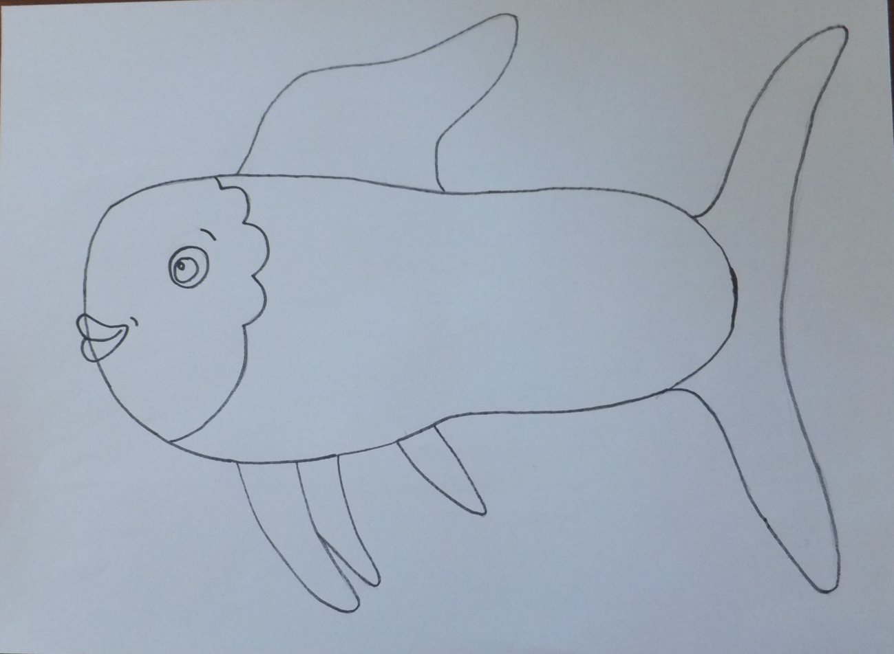
2. Draw on some fins, make them look however you like
3. Draw a face, any face you like

Slide 4
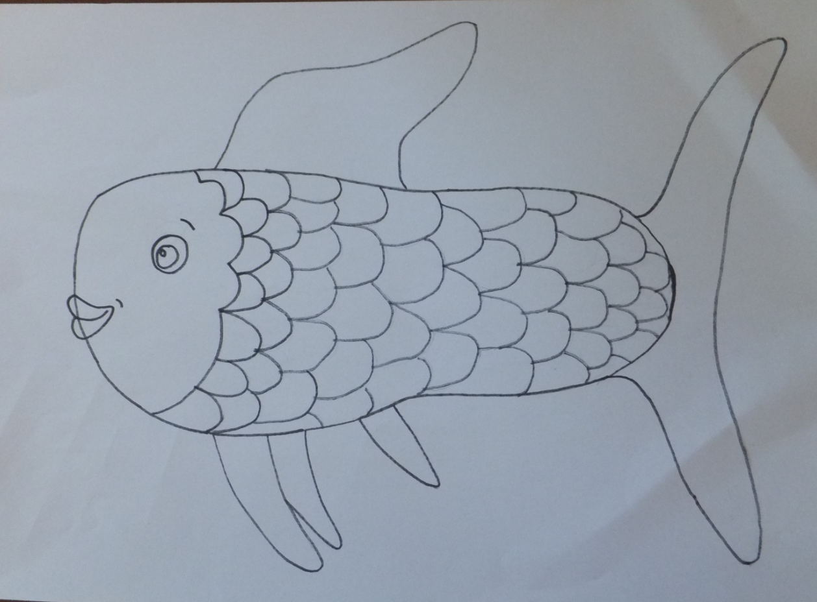
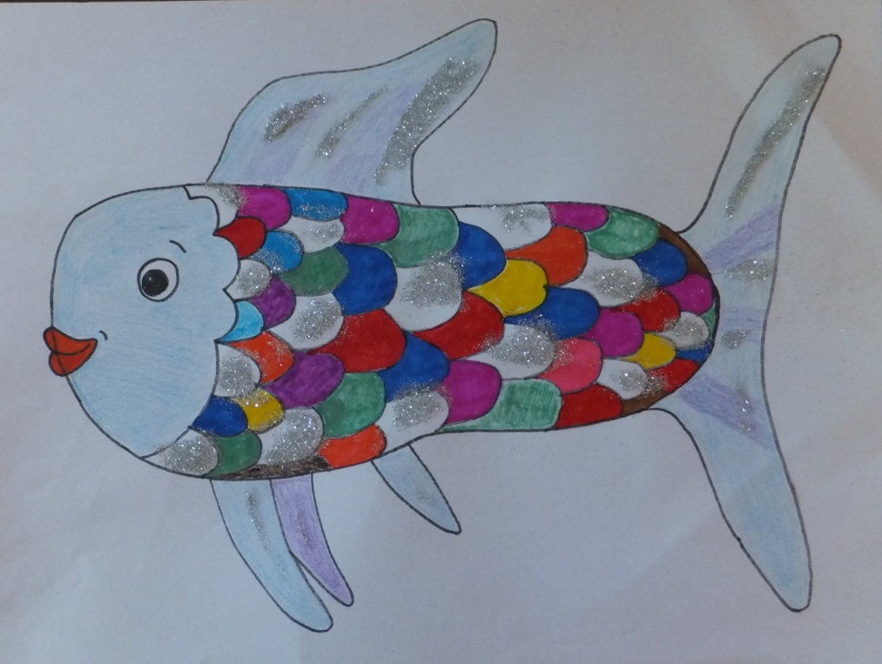
4. Draw some scales, or whatever you like on the body
5. Colour it in, or use glitter, stickers, cuttings
Use any shapes and colours you like

Slide 5
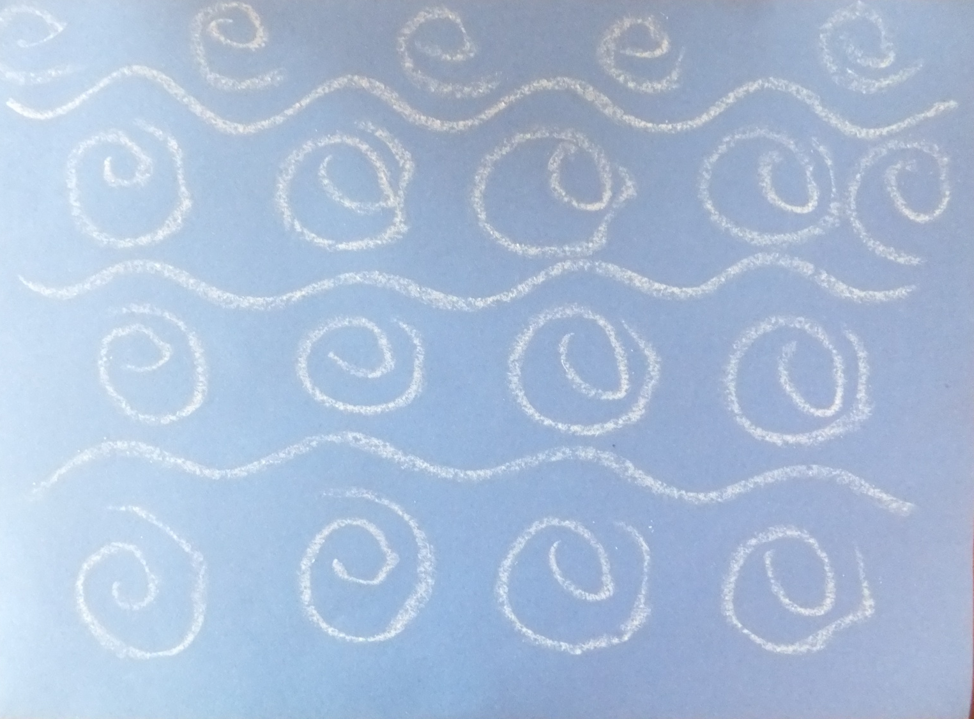
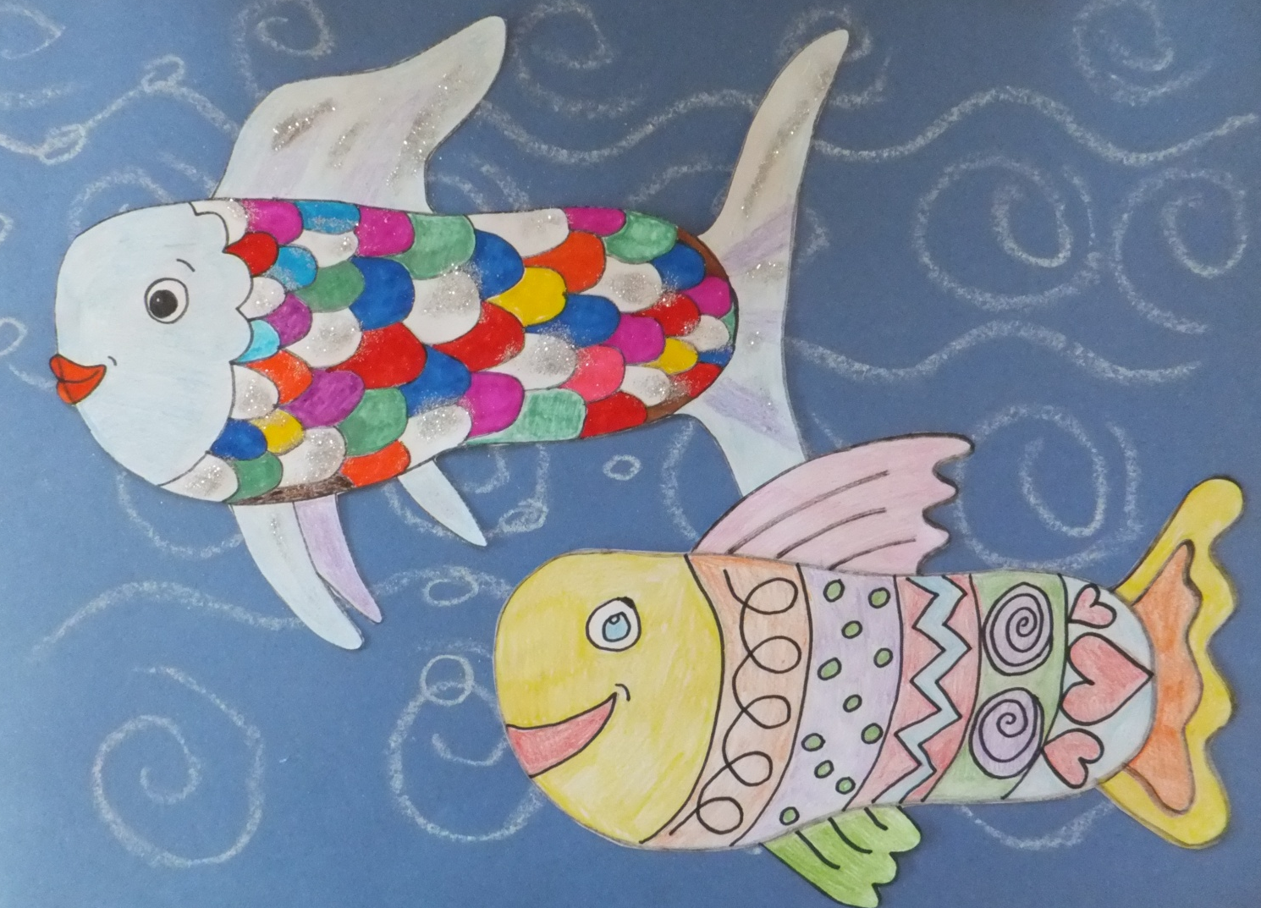
6. You could colour in the background, or make more fish, maybe your family would like to make one each, cut them out, and stick them into your very own family ‘aquarium’
Miss Thurlow

