Slide 1
Creating a bird from nature

Slide 2
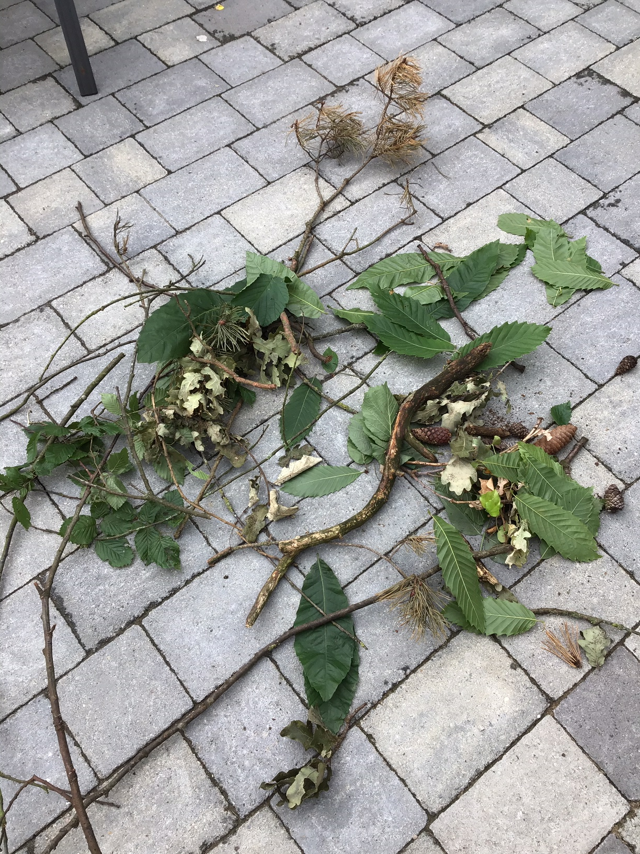
I had the excellent services of 4 young men help me collect twigs, leaves and various bits from outside.

Slide 3
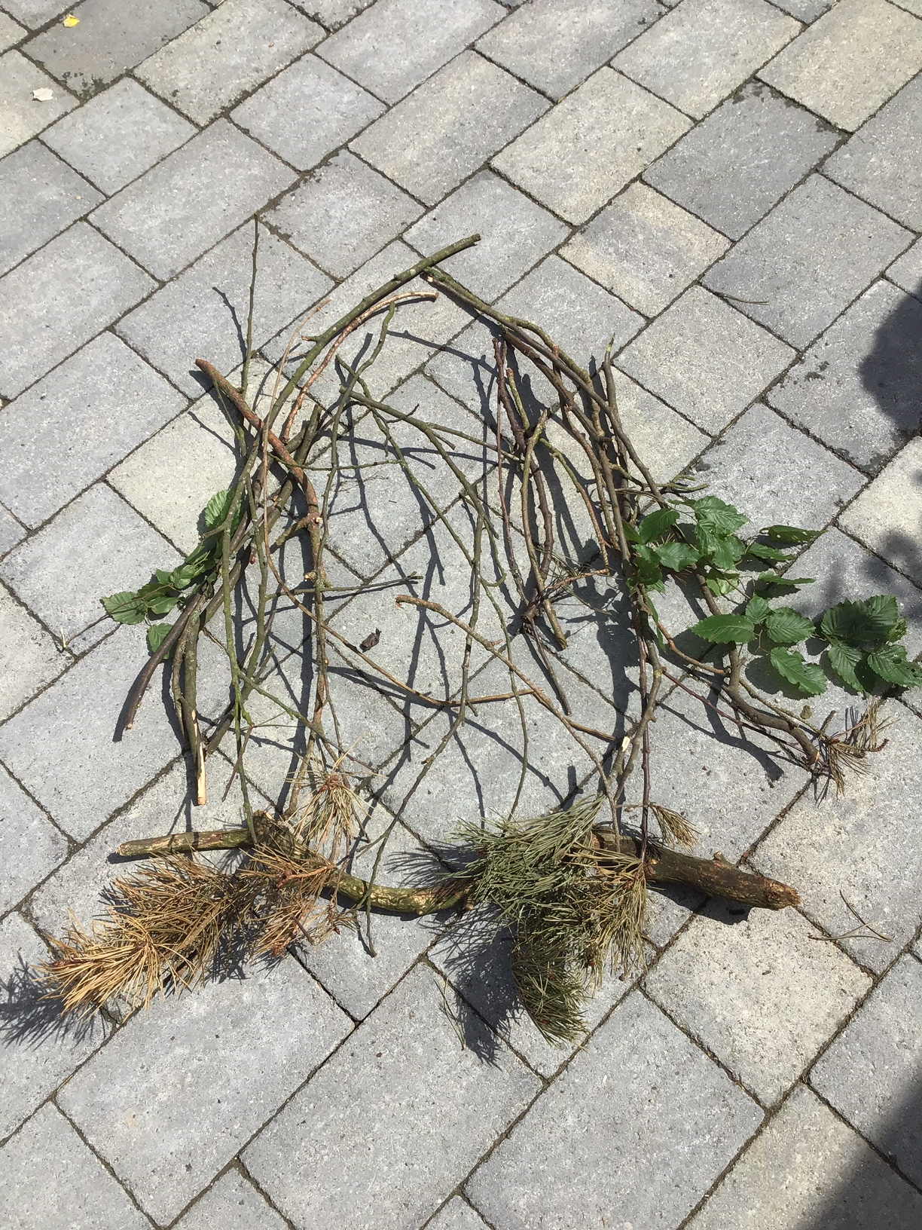
Slowly start shaping your twigs and leaves into the bird you are creating.
It doesn’t have to be a bird, it can be anything you choose.

Slide 4
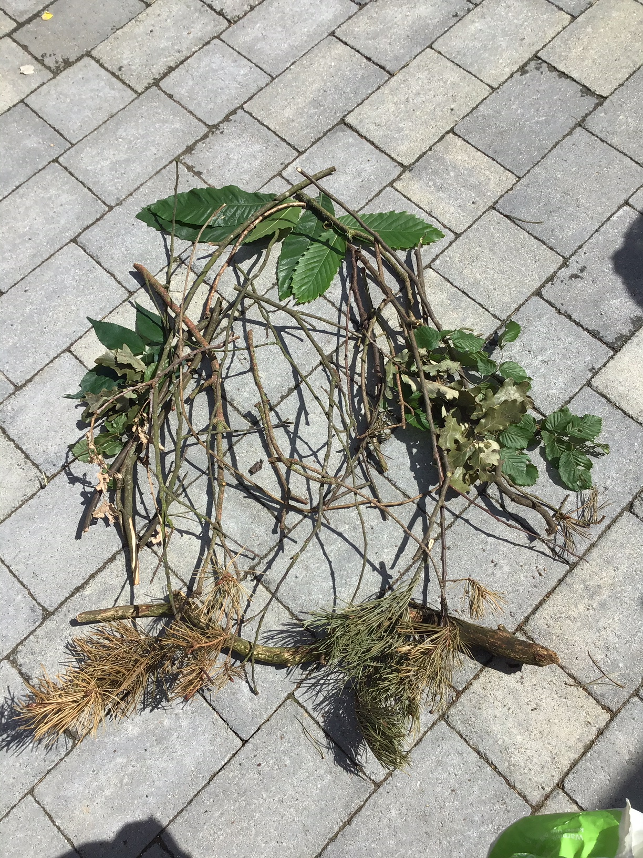
Keep on slowly creating your shape, don’t rush and change bits if you need to.

Slide 5
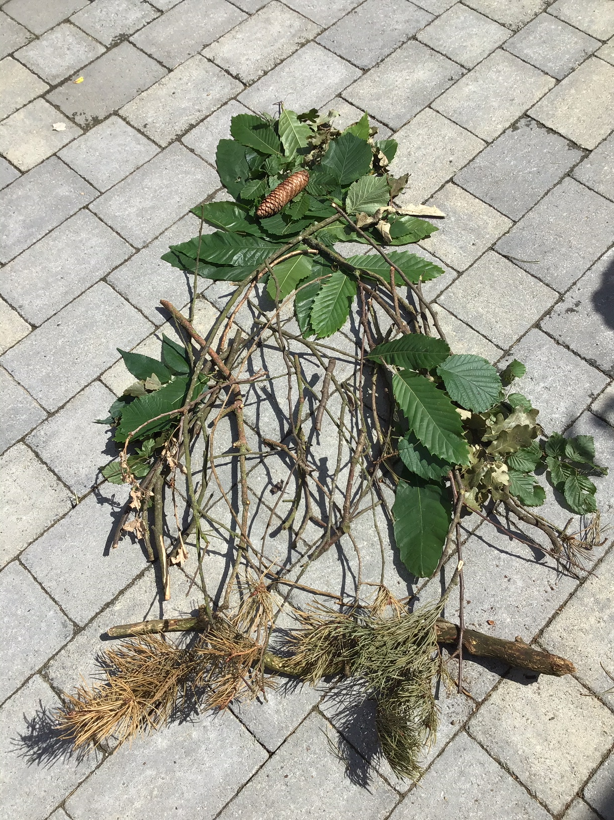
Start adding more detail to your creation.
The head is now taking shape.

Slide 6
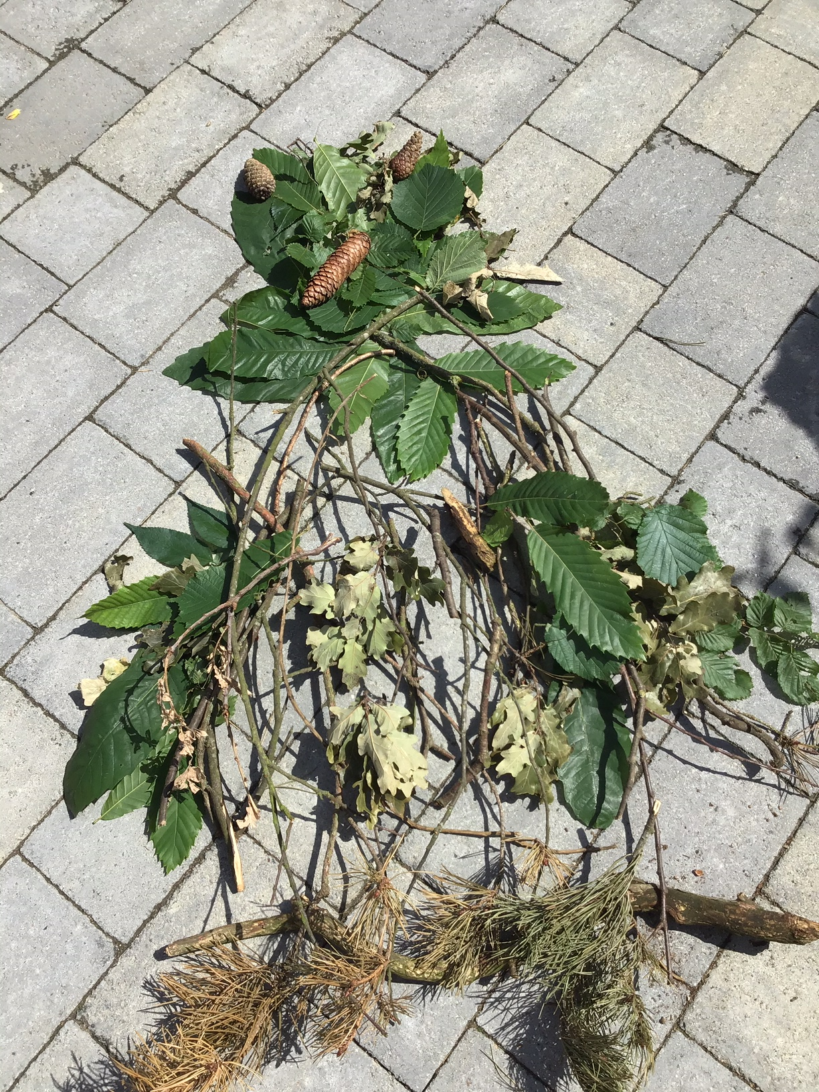
Keep going with the details.
I’ve now added a beak and ears.

Slide 7
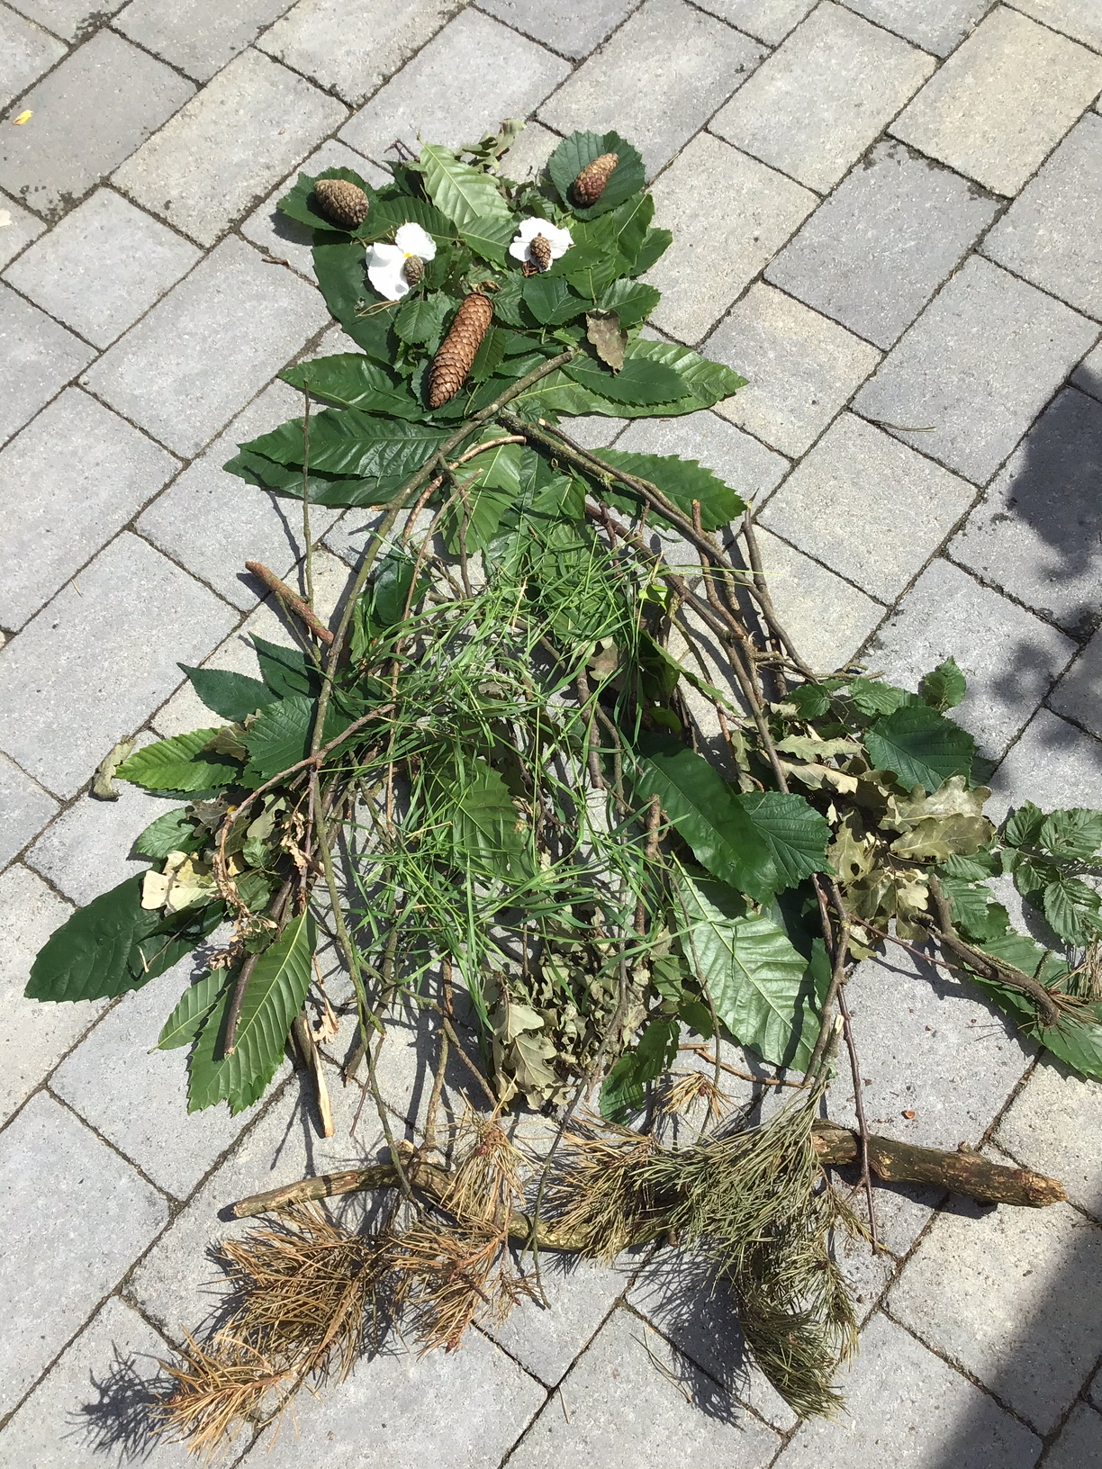
Put on your finishing touches. I have added eyes and filled in more of the body.
I have created and owl.
What can you create from finding bits from nature?

