Slide 1
MAKING A LAVENDER POUCH for a restful nights sleep

Slide 2
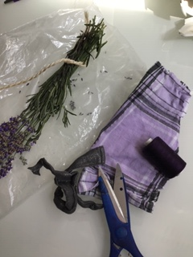
Items needed:
Lavender, that has been dried out for at least a week
Scrap cloth
Scissors
Needle and thread (or a sewing machine)

Slide 3
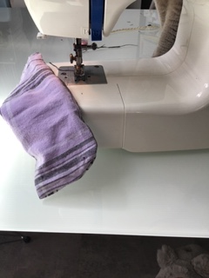
Machine your scrap cloth big enough for the amount of lavender you have collected.

Slide 4
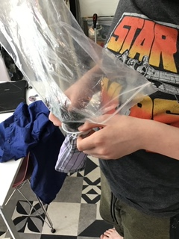
Once you have stitched the bottom and sides, carefully fill the pouch with your dried lavender.

Slide 5
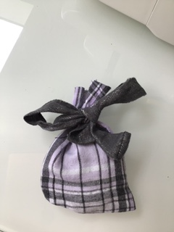
Once filled I machined mine at the top and tied with a nice bow. Pop under your pillow at night for a relaxing nights sleep.

