Slide 1
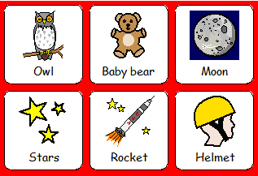
Labelling a picture linked to story Whatever next
Talk to the children about the picture.
What can they see?
Who is flying to the moon?
Print of symbols and ask the children can they find the owl? Stick the symbol on to the picture and continue to do this with all symbols.

Slide 2
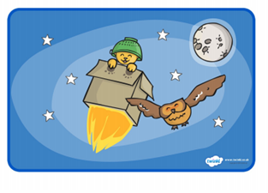
Example:
Moon
Helmet
Teddy bear
Rocket
Star
Owl

